Slide 1

Unit – 2 Finite Automata
Theory of Computation (TOC)
DU # 2101CS603
Prof. Dixita B. Kagathara
Computer Engineering Department
dixita.kagathara@darshan.ac.in
+91 - 97277 47317 (CE Department)

Slide 2
Topics to be covered
Regular expressions & Regular languages
Finite Automata
Union, Intersection and Complement of Regular Languages
Non-Deterministic Finite Automata
Conversion from NFA to FA
^ - Non-Deterministic Finite Automata
Conversion of NFA-^ to FA
Kleene’s Theorem Part – I
Finite Automata with Output (Moore machine, Mealy machine)
Minimization of FA
Pumping Lemma – Regular and Non Regular Languages

Looping

Slide 3
Regular Expression

Slide 4
Formal language
A formal language is a collection of valid sentences, where each sentence is a sequence of words, and each word is a sequence of graphic symbols acceptable in a language.
Set of rules that specify the construction of words and sentences is called formal language grammar.
Graphical symbols
{ a,b,c,d,e,f,g,h,i...........0,1,2,3.............}
words
{the, system, welcome, hello, computer, to, programming }
sentence
“hello to programming”

Slide 5
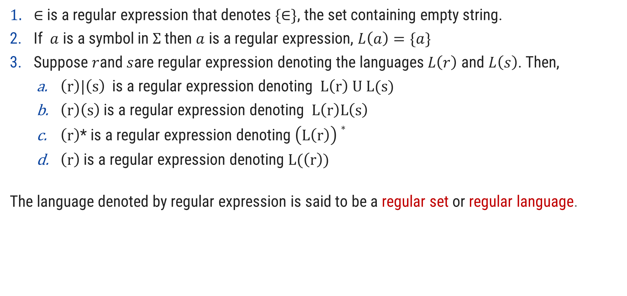
Regular languages and Regular Expression over $Σ$
$∈$is a regular expression that denotes $\{∈\}$, the set containing empty string.
If $a$ is a symbol in $Σ$then $a$ is a regular expression, $L\left(a\right)=\{a\}$
Suppose $r$and $s$are regular expression denoting the languages$L\left(r\right)$ and $L\left(s\right)$. Then,
$\left(r\right)|\left(s\right)$ is a regular expression denoting $L\left(r\right) U L(s)$
$\left(r\right)\left(s\right)$ is a regular expression denoting $L\left(r\right)L\left(s\right)$
$\left(r\right)$* is a regular expression denoting $\left(L\left(r\right)\right)∗$
$\left(r\right)$ is a regular expression denoting $L(\left(r\right))$
The language denoted by regular expression is said to be a regular set or regular language.

Slide 6
Regular expression
A regular expression is a sequence of characters that defines a pattern.
Notational shorthand's
One or more instances: +
Zero or more instances: *
Zero or one instances: ?
Alphabets: Σ

Slide 7
Regular expression
a*
L = Zero or More Occurrences of a =
*
^
a
aa
aaa
Infinite …..
aaaa
aaaaa…..

Slide 8
Regular expression
a⁺
L = One or More Occurrences of a =
+
a
aa
aaa
Infinite …..
aaaa
aaaaa…..

Slide 9
Precedence and associativity of operators
Operator | Precedence | Associative
Kleene * | 1 | left
Concatenation | 2 | left
Union | | 3 | left

Slide 10

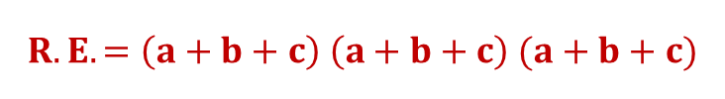



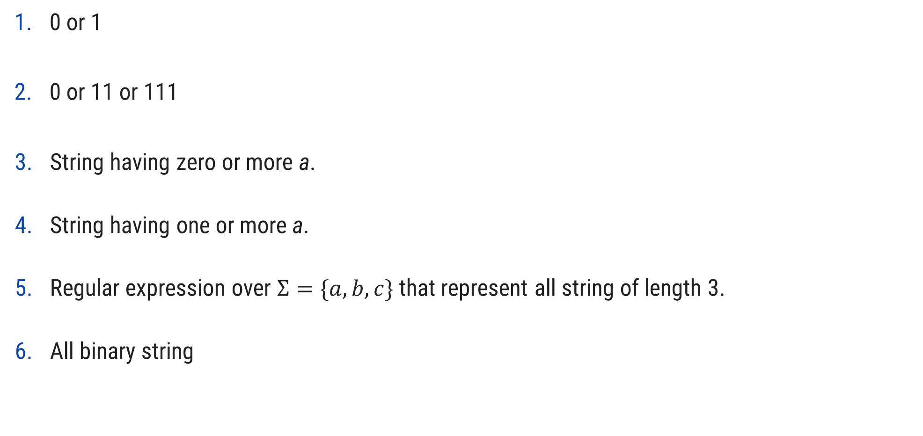






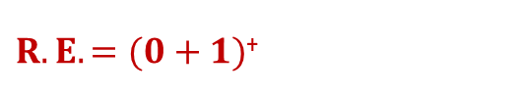
Regular expression examples
0 or 1
0 or 11 or 111
String having zero or more a.
String having one or more a.
Regular expression over $Σ=\{a,b,c\}$ that represent all string of length 3.
All binary string
$$Strings: 0, 1$$
$$R.E. =0+1$$
$$Strings: 0, 11, 111$$
$$R.E. =0+11+111$$
$$R.E. =a∗$$
$$Strings: ^,a, aa, aaa, aaaa…..$$
$$Strings:a, aa, aaa, aaaa…..$$
$$R.E. =a+$$
$$Strings:abc, bca, bbb, cab, aba….$$
$$R.E. =\left(a+b+c\right) \left(a+b+c\right) (a+b+c)$$
$$Strings: 0, 11, 101, 10101, 1111…$$
$R.E. =(0+1)$⁺

Slide 11
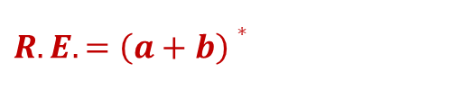











Regular expression examples
0 or more occurrence of either a or b or both
1 or more occurrence of either a or b or both
Binary no. ends with 0
Binary no. ends with 1
Binary no. starts and ends with 1 and length of string is at least 2
String starts and ends with same character
$$Strings:^,a, aa, abab, bab…$$
$$R.E. =\left(a+b\right)∗$$
$$Strings:a, aa, abab, bab, bbbaaa…$$
$R.E. =(a+b)$⁺
$R.E. =(0+1)$ $∗$ $0$
$$Strings: 0, 10, 100, 1010, 11110…$$
$$R.E. =(0+1) ∗1$$
$$Strings:1, 101, 1001, 10101, …$$
$$Strings: 11, 101, 1001, 10101, …$$
$$R.E. =1 (0+1)∗1$$
$$Strings:00, 101, aba, baab…$$
$$R.E. =1 \left(0+1\right)∗1 or 0 \left(0+1\right)∗0$$
$$a (a+b)∗a or b (a+b)∗b$$

Slide 12




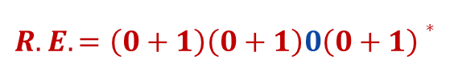
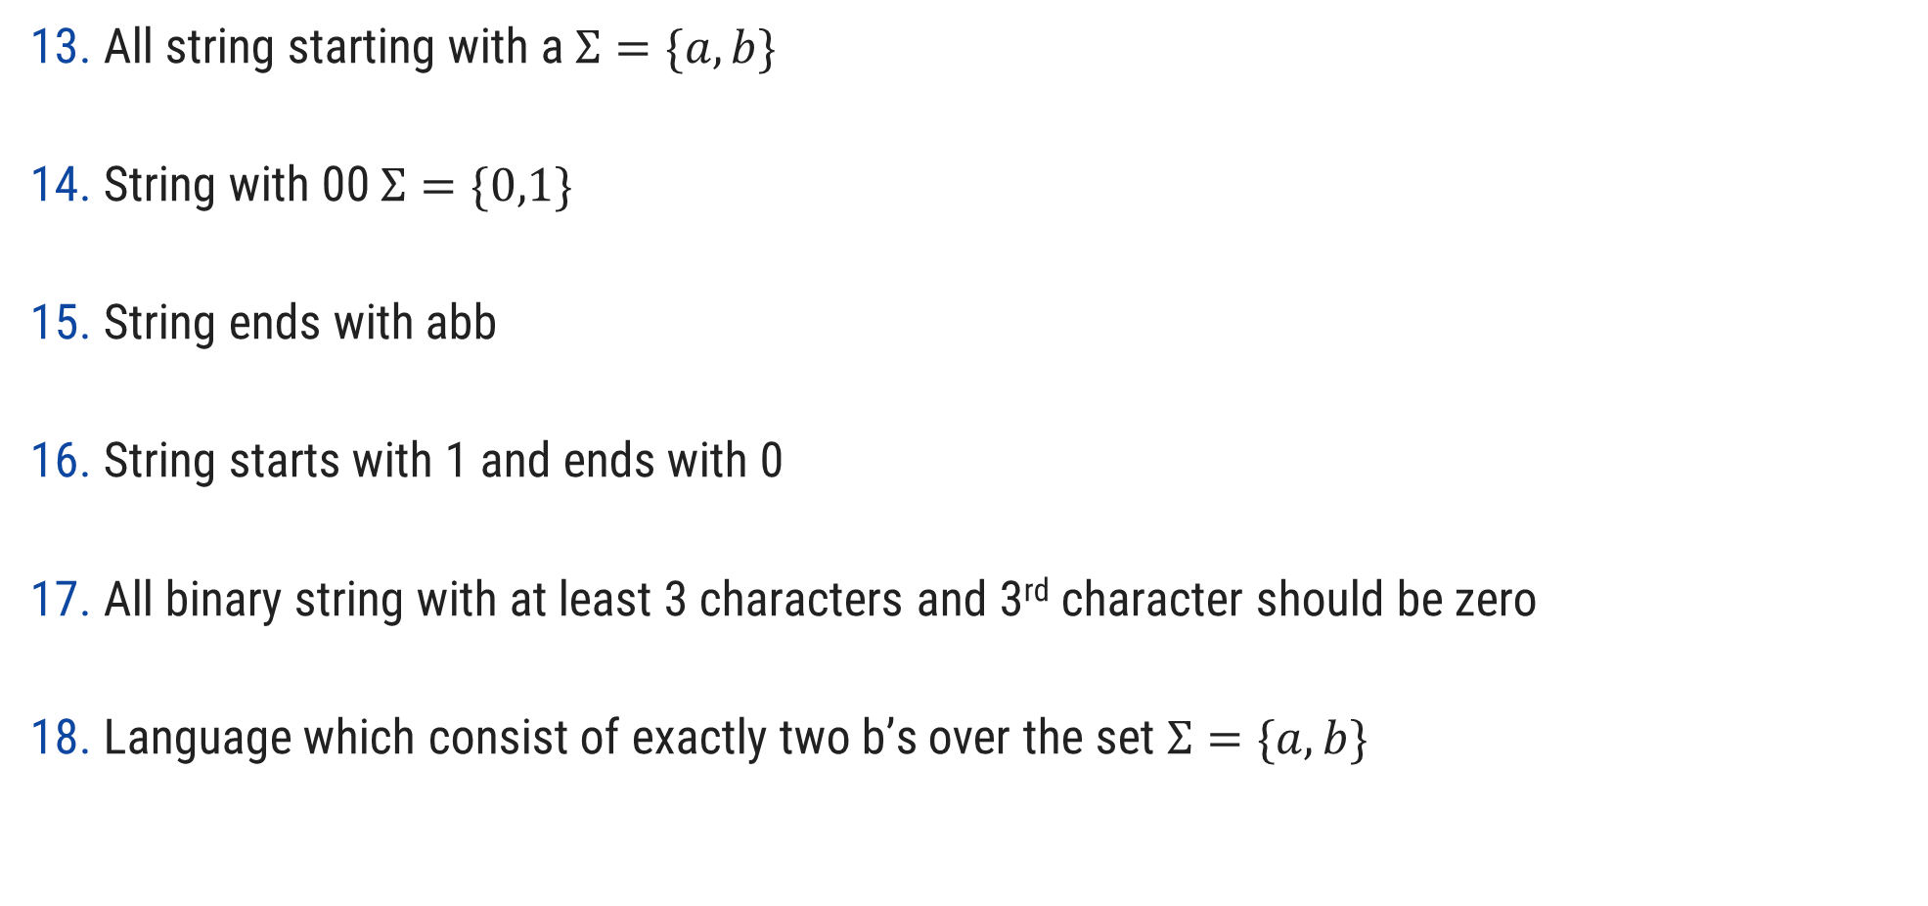




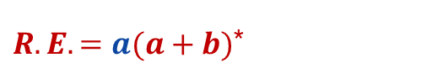


Regular expression examples
All string starting with a $Σ=\{a,b\}$
String with 00 $Σ=\{0,1\}$
String ends with abb
String starts with 1 and ends with 0
All binary string with at least 3 characters and 3rd character should be zero
Language which consist of exactly two b’s over the set $Σ=\{a,b\}$
$Strings:a,ab,aab,abb$…
$R.E. =a(a+b)$*
$Strings:00,100,000,1000,1100$…
$$R.E. =(0+1)\text{∗}00$$
$Strings:abb,babb, ababb$…
$$R.E. =\left(a+b\right)\text{∗} abb$$
$Strings:10,100,110,1000,1100$…
$$R.E. =1\left(0+1\right)\text{∗} 0$$
$Strings:000,100,1100,1001$…
$$R.E. =\left(0+1\right)\left(0+1\right)0\left(0+1\right)∗$$
$Strings:bb,bab,aabb,abba$…
$$R.E. =a∗b a∗b a∗$$

Slide 13
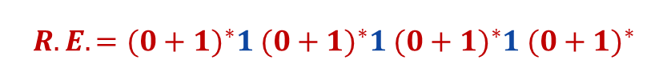



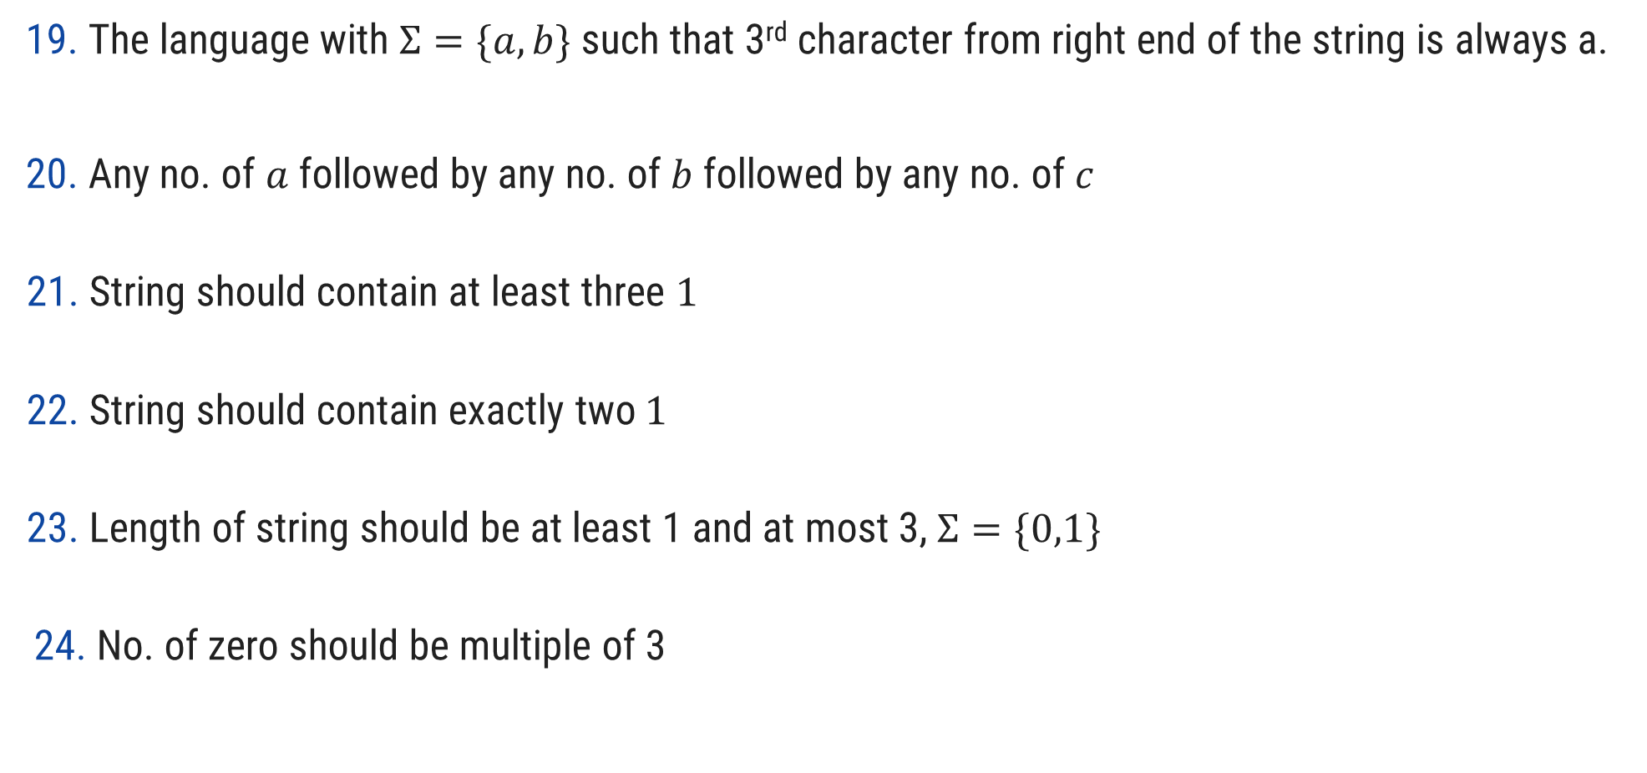




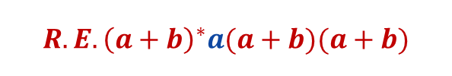


Regular expression examples
The language with $Σ=\{a,b\}$ such that 3rd character from right end of the string is always a.
Any no. of $a$ followed by any no. of $b$ followed by any no. of $c$
String should contain at least three $1$
String should contain exactly two $1$
Length of string should be at least 1 and at most 3, $Σ=\{0,1\}$
No. of zero should be multiple of 3
$Strings:aaa,aba,aaba,abb$…
$$R.E.{\left(a+b\right)}^{∗}a(a+b)(a+b)$$
$Strings:^,abc,aabbcc,aabc,abb$…
$$R.E. =a∗b∗c∗$$
$Strings:111,01101,0101110$….
$$R.E. ={(0+1)}^{∗}1{ (0+1)}^{∗}1{ (0+1)}^{∗}1 {(0+1)}^{∗}$$
$Strings:11,0101,1100,010010,100100$….
$$R.E. =0^{∗}10^{∗}10^{∗}$$
$Strings:0,1,11,01,111,010,100$….
$$R.E. =\left(0+1\right)+(0+1)(0+1)+\left(0+1\right)\left(0+1\right)\left(0+1\right)$$
$Strings:000,010101,110100,000000$….
$$R.E. ={(1^{∗}01^{∗}01^{∗}01^{∗})}^{∗}$$

Slide 14





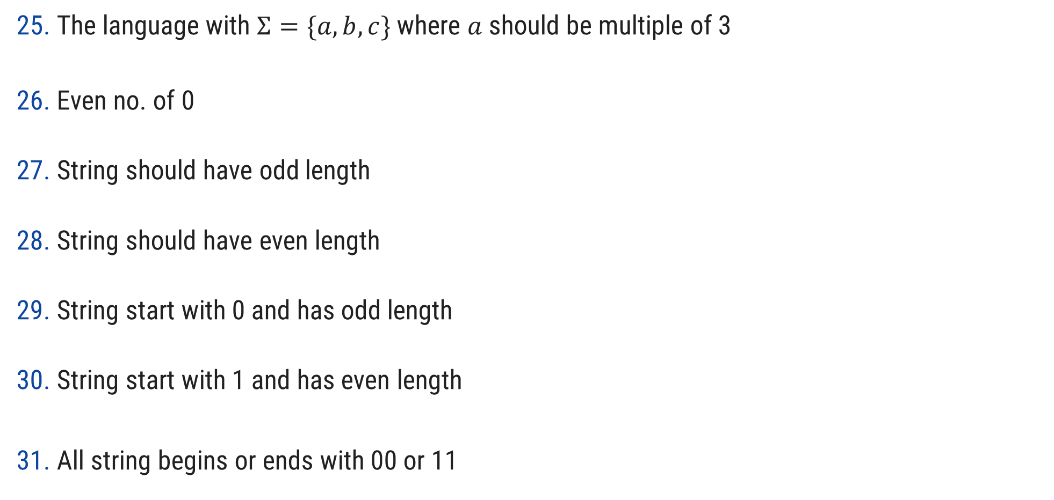
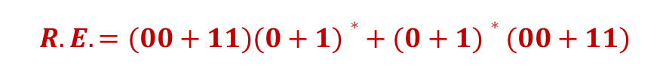








Regular expression examples
The language with $Σ=\{a,b,c\}$ where $a$ should be multiple of 3
Even no. of 0
String should have odd length
String should have even length
String start with 0 and has odd length
String start with 1 and has even length
All string begins or ends with 00 or 11
$$Strings:aaa, baaa,bacaba,aaaaaa..$$
$$R.E. ={({\left(b+c\right)}^{∗}a{\left(b+c\right)}^{∗}a{\left(b+c\right)}^{∗}a{\left(b+c\right)}^{∗})}^{∗}$$
$Strings:00,0101,0000,100100$….
$$R.E. ={(1^{∗}01^{∗}01^{∗})}^{∗}$$
$Strings:0,010,110,000,10010$….
$$R.E. ={\left(0+1\right) ((0+1) (0+1))}^{∗}$$
$Strings:00,0101,0000,100100$….
$$R.E. ={ ((0+1) (0+1))}^{∗}$$
$Strings:0,010,010,000,00010$….
$$R.E. ={\left(0\right) ((0+1)(0+1))}^{∗}$$
$Strings:10,1100,1000,100100$….
$$R.E. ={ 1(0+1)((0+1)(0+1))}^{∗}$$
$$Strings: 00101, 10100,110,01011…$$
$$R.E. =(00+11)(0+1)∗+ (0+1)∗(00+11)$$

Slide 15






Regular expression examples
Language of all string containing both 11 and 00 as substring
String ending with 1 and not contain 00
Language of C identifier
$$Strings: 1100,100110,010011…$$
$$R.E. ={((0+1)}^{∗}00{ (0+1)}^{∗}11{ (0+1)}^{∗})+{((0+1)}^{∗}11{ (0+1)}^{∗}00{ (0+1)}^{∗})$$
$$Strings: 011, 1101,1011….$$
$$R.E. =(1+01)+$$
$$Strings:area, i, redious, grade1….$$
$$R.E. ={(L)( L +D)}^{∗}$$
$$where L is Letter \& D is digit$$

Slide 16
Finite Automata

Slide 17
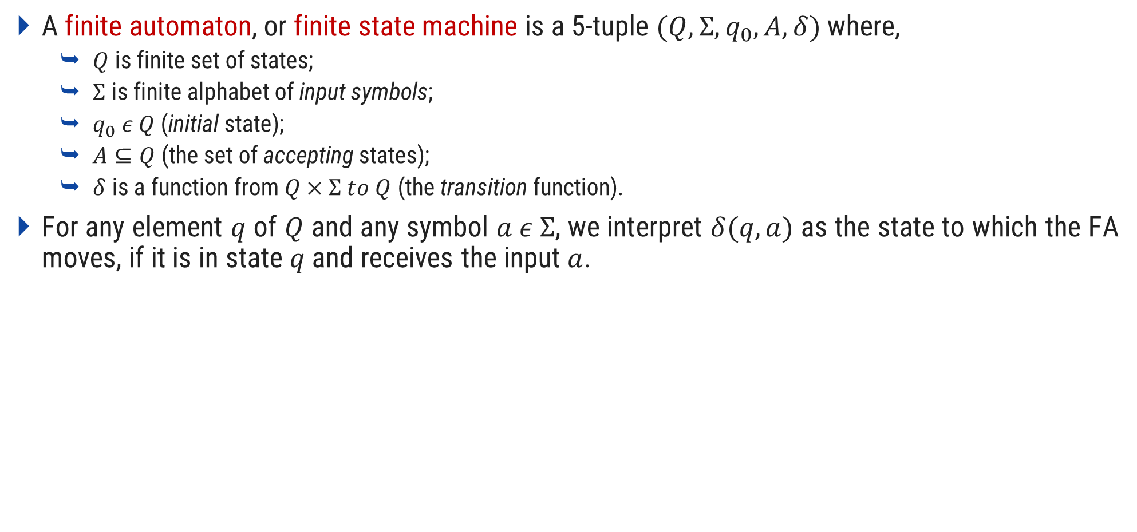
Finite Automata
A finite automaton, or finite state machine is a 5-tuple $(Q,Σ,q_{0},A,δ)$ where,
$Q$ is finite set of states;
$Σ$ is finite alphabet of input symbols;
$q_{0} ε Q$ (initial state);
$A⊆Q$ (the set of accepting states);
$δ$ is a function from $Q×Σ to Q$ (the transition function).
For any element $q$ of $Q$ and any symbol $a ε Σ$, we interpret $δ(q,a)$ as the state to which the FA moves, if it is in state $q$ and receives the input $a$.

Slide 18
Applications of FA
Lexical analysis phase of a compiler.
Design of digital circuit.
String matching.
Communication Protocol for information exchange.

Slide 19
Symbols
is a state
is a transition
is a start state
is a final state

Slide 20
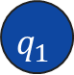

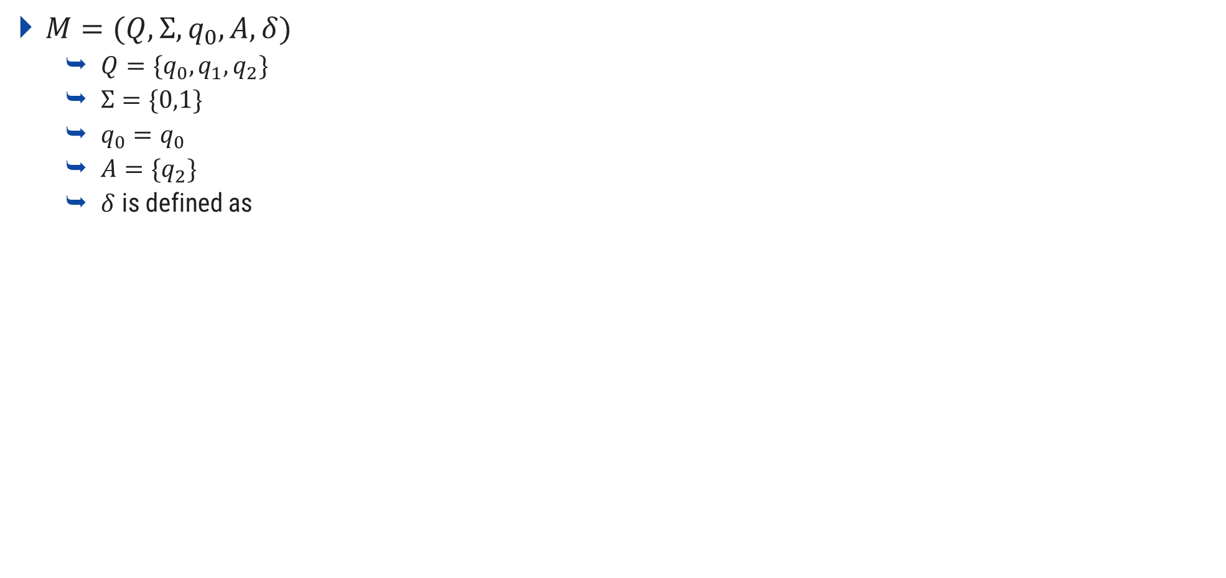
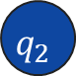
Example: Finite Automata
$M=(Q,Σ,q_{0},A,δ)$
$Q=\{q_{0},q_{1},q_{2}\}$
$Σ=\{0,1\}$
$q_{0}=q_{0}$
$A=\{q_{2}\}$
$δ$ is defined as
δ | Input
Set of states
State | $$0$$ | $$1$$
Input symbols
$$q_{0}$$ | $$q_{1}$$ | $$q_{0}$$
Initial state
$$q_{1}$$ | $$q_{2}$$ | $$q_{0}$$
Acceptance state
$$q_{2}$$ | $$q_{2}$$ | $$q_{0}$$
1
1
0
$$q_{0}$$
0
$$q_{1}$$
0
$$q_{2}$$
1

Slide 21
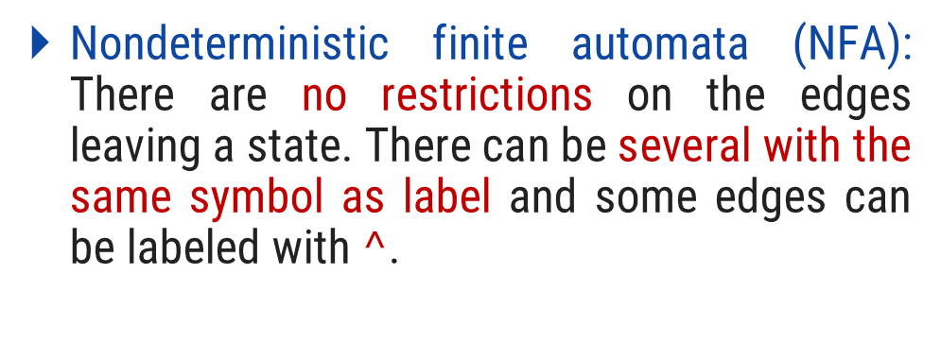
Types of Finite Automata
Types of finite automata are:
DFA
b
Deterministic finite automata (DFA): have for each state exactly one edge leaving out for each symbol.
1
a
2
b
3
b
4
a
a
b
a
NFA
DFA
Nondeterministic finite automata (NFA): There are no restrictions on the edges leaving a state. There can be several with the same symbol as label and some edges can be labeled with $^$.
a
1
a
2
b
3
b
4
b
NFA

Slide 22
Identify NFA or DFA?
0
0
1
0
1
3
0
1
1
2
3
1
1
0
2
1
1
0
4
0
DFA
1
a
DFA
0,1
a
b
b
1
1
2
3
4
1
1
2
0
3
b
NFA
0
NFA

Slide 23
Design of FA
1. Design FA which accept input ‘101’
2. Design FA which accept input ‘aba’
1
1
2
0
3
1
4
1
a
2
b
3
a
4
1
0
a
b
0
b
0, 1
a, b
D
D
Dead State
Dead State

Slide 24
Design of FA
Design FA which accept all strings starts with ‘abb’
Design FA which accept all strings ends in 1
a, b
0
1
1
a
2
b
3
b
4
1
1
2
0
a
a
b
D
Dead State

Slide 25
Design of FA
Design FA which accept all strings ends in 0
Design FA which accept all strings starts with 1 ends in 0
1
0
1
0
1
1
2
0
3
1
0
2
0
1
1
D
Dead State

Slide 26






Design of FA
Design FA which accept all strings ends in 00
Design FA which accept all strings ends in 10
0
0
1
1
0
0
0
$$3$$
1
$$1$$
$$2$$
$$1$$
$$2$$
$$3$$
1
1
1
0

Slide 27






Design of FA
Design FA which accept all strings ends in 01
Design FA which accept all strings ends in 11
1
0
0
1
1
0
1
1
$$1$$
$$2$$
$$3$$
$$1$$
$$2$$
$$3$$
0
0
1
0

Slide 28
Design of FA
Design FA which accept all strings ends in abb
Design FA which accept all strings having ‘aa’ as substring
b
a
b
a,b
a
b
b
1
a
2
a
3
1
2
3
4
a
b
a
b

Slide 29
Design of FA
Design FA which accept odd number of ‘a’
Design FA which accept all strings having at least two zero
b
b
1
1
0, 1
a
1
0
2
0
3
1
2
a

Slide 30
Design of FA
Design FA which accept all strings having at most two zero
Design FA which accept all strings having number of 1 is in multiple of 3
1
1
1
0
0
0
0
0
1
1
2
1
3
1
2
3
0
1
D
Dead State

Slide 31
Design of FA
The string with next to last symbol as 0. (ends with 00 or 01)
The string with number of 0’s and number of 1’s are odd
1
0
odd 0 odd 1
odd 0 even 1
3
1
1
0
1
0
2
0
0
0
0
1
1
1
0
odd 1 even 0
even 1 even 0
4
1
1

Slide 32
Design of FA
The string ending in 10 or 11
Design FA corresponding to Regular expression {00}*{11}*
1
Dead State
3
1
0,1
0
2
5
1
1
0
0
1
2
0
0
0
0
1
1
1
1
3
4
0
4
1

Slide 33
Design of FA
Design FA which accept (a+b)*baaa
b
a
2
a
b
b
1
3
b
b
a
a
a
5
4

Slide 34
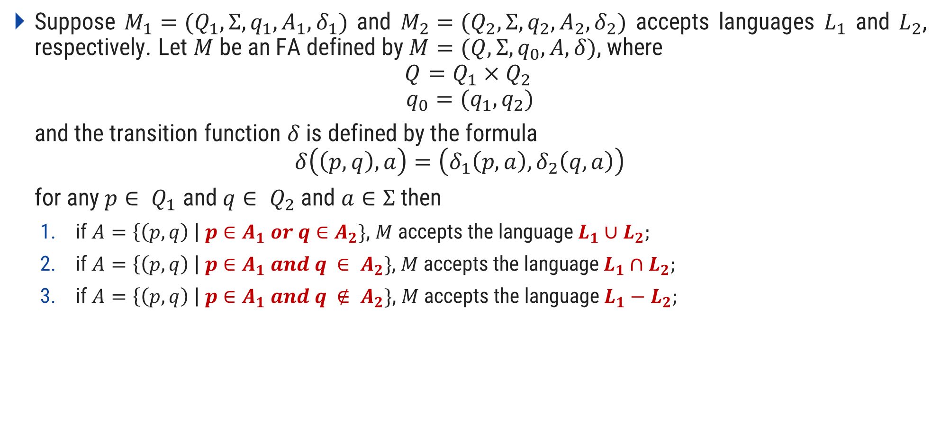
Union, Intersection & Complement of Languages
Suppose $M_{1}=(Q_{1},Σ,q_{1},A_{1},δ_{1})$ and $M_{2}=(Q_{2},Σ,q_{2},A_{2},δ_{2})$ accepts languages $L_{1}$ and $L_{2}$, respectively. Let $M$ be an FA defined by $M=(Q,Σ,q_{0},A,δ)$, where
$$Q=Q_{1}×Q_{2 }$$
$$q_{0}=(q_{1},q_{2})$$
and the transition function $δ$ is defined by the formula
$$δ\left(\left(p,q\right),a\right)=\left(δ_{1}\left(p,a\right),δ_{2}\left(q,a\right)\right)$$
for any $p∈ Q_{1}$ and $q∈ Q_{2}$ and $a∈Σ$ then
if $A=\left\{\left(p,q\right) \right| p∈A_{1} or q∈A_{2}\}$, $M$ accepts the language $L_{1}∪L_{2};$
if $A=\left\{\left(p,q\right) \right| p∈A_{1} and q ∈ A_{2}\}$, $M$ accepts the language $L_{1}∩L_{2};$
if $A=\left\{\left(p,q\right) \right| p∈A_{1} and q ∉ A_{2}\}$, $M$ accepts the language $L_{1}−L_{2};$

Slide 35



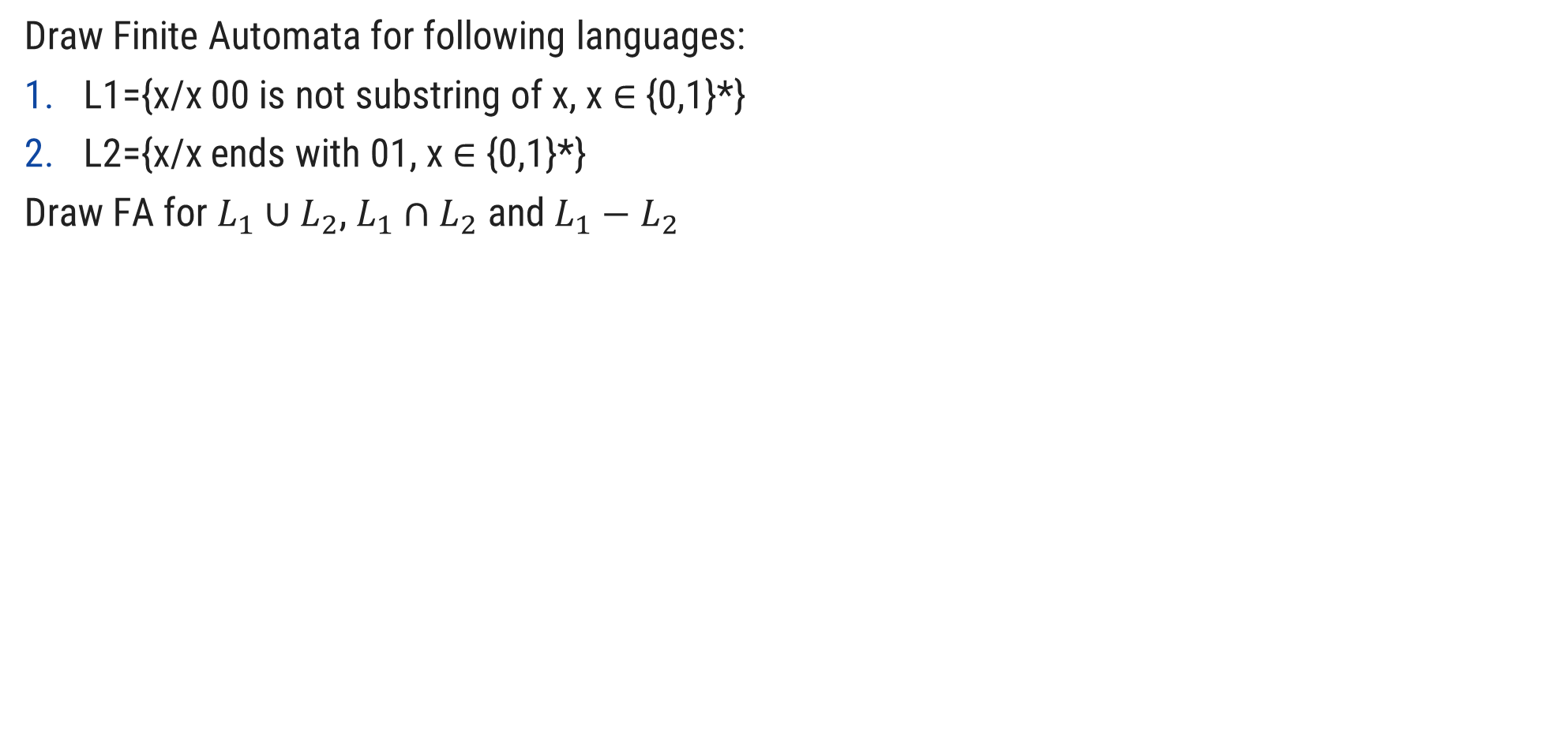


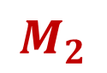

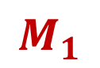
Example: Union, Intersection & Complement of Languages
Draw Finite Automata for following languages:
L1={x/x 00 is not substring of x, x ∈ {0,1}*}
L2={x/x ends with 01, x ∈ {0,1}*}
Draw FA for $L_{1}∪L_{2}$, $L_{1}∩L_{2}$ and $L_{1}−L_{2}$
1
0,1
1
0
0
1
$$A$$
$$B$$
0
$$C$$
$$P$$
0
$$Q$$
$$R$$
1
0
1
$$M_{1}$$
$$M_{2}$$

Slide 36
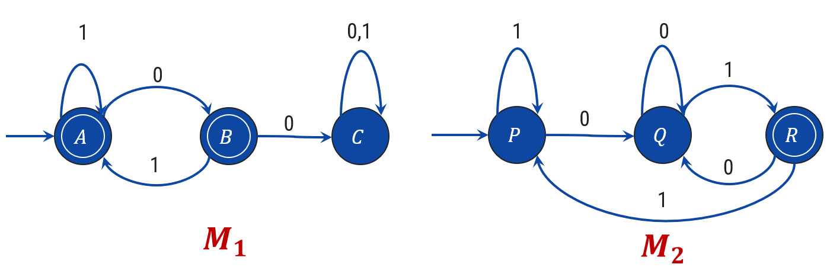
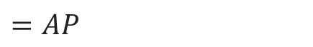

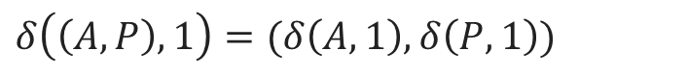



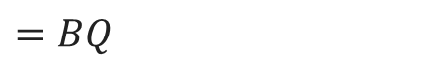

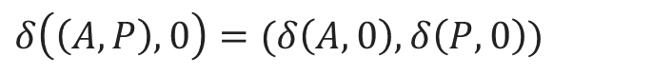


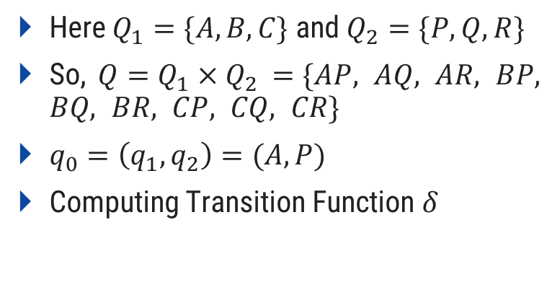


Computation for $L_{1}∪L_{2}$, $L_{1}∩L_{2}$ and $L_{1}−L_{2}$
Here $Q_{1}=\{A,B,C\}$ and $Q_{2}=\{P,Q,R\}$
So, $Q=Q_{1}×Q_{2 }=\{AP, AQ, AR, BP, BQ, BR, CP, CQ, CR\}$
$q_{0}=\left(q_{1},q_{2}\right)=(A,P)$
Computing Transition Function $δ$
1
$$AP$$
$$BP$$
$$CP$$
0
$$δ\left(\left(A,P\right),0\right)=(δ\left(A,0\right),δ\left(P,0\right))$$
$$AQ$$
$$BQ$$
$$CQ$$
$$=BQ$$
$$δ\left(\left(A,P\right),1\right)=(δ\left(A,1\right),δ\left(P,1\right))$$
$$=AP$$
$$AR$$
$$BR$$
$$CR$$
BQ

Slide 37

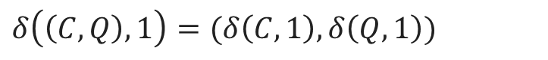
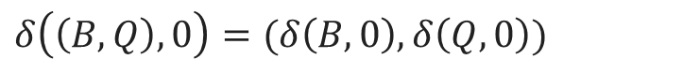
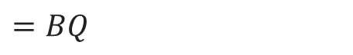
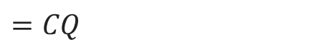
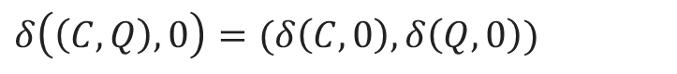
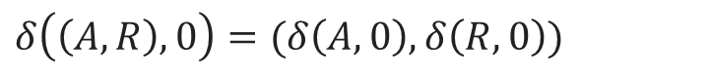
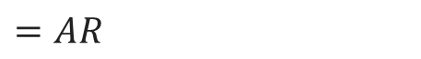
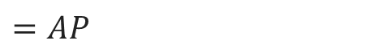
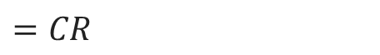
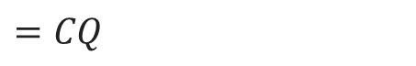
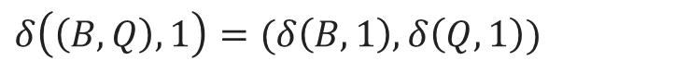
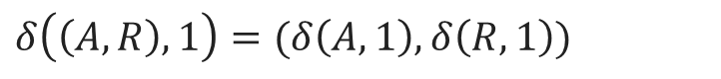
Computation for $L_{1}∪L_{2}$, $L_{1}∩L_{2}$ and $L_{1}−L_{2}$
$$δ\left(\left(B,Q\right),0\right)=(δ\left(B,0\right),δ\left(Q,0\right))$$
$$=CQ$$
1
$$δ\left(\left(B,Q\right),1\right)=(δ\left(B,1\right),δ\left(Q,1\right))$$
$$=AR$$
$$AP$$
$$BP$$
$$CP$$
$$δ\left(\left(C,Q\right),0\right)=(δ\left(C,0\right),δ\left(Q,0\right))$$
$$=CQ$$
0
0
$$δ\left(\left(C,Q\right),1\right)=(δ\left(C,1\right),δ\left(Q,1\right))$$
$$AQ$$
$$BQ$$
0
$$CQ$$
$$=CR$$
1
$$δ\left(\left(A,R\right),0\right)=(δ\left(A,0\right),δ\left(R,0\right))$$
0
1
$$=BQ$$
1
$$δ\left(\left(A,R\right),1\right)=(δ\left(A,1\right),δ\left(R,1\right))$$
$$AR$$
$$BR$$
$$CR$$
$$=AP$$
BQ
CQ
AR
CR

Slide 38
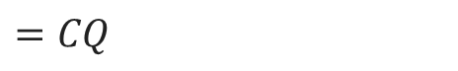
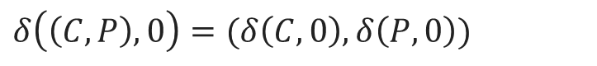
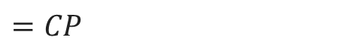

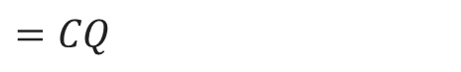
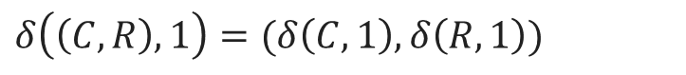
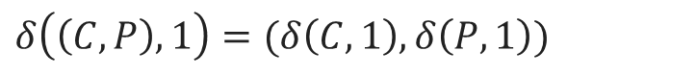
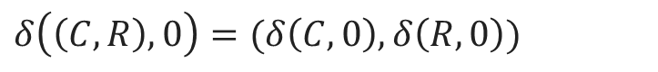
Computation for $L_{1}∪L_{2}$, $L_{1}∩L_{2}$ and $L_{1}−L_{2}$
$$δ\left(\left(C,R\right),0\right)=(δ\left(C,0\right),δ\left(R,0\right))$$
1
1
$$=CQ$$
$$δ\left(\left(C,R\right),1\right)=(δ\left(C,1\right),δ\left(R,1\right))$$
$$AP$$
$$BP$$
$$CP$$
$$=CP$$
0
$$δ\left(\left(C,P\right),0\right)=(δ\left(C,0\right),δ\left(P,0\right))$$
0
0
$$=CQ$$
$$AQ$$
$$BQ$$
0
$$CQ$$
1
$$δ\left(\left(C,P\right),1\right)=(δ\left(C,1\right),δ\left(P,1\right))$$
0
0
1
$$=CP$$
1
$$AR$$
$$BR$$
$$CR$$
BQ
CQ
AR
CR
CP

Slide 39









Removing Unconnected States
1
1
$$AP$$
$$BP$$
$$CP$$
0
0
0
$$AQ$$
$$BQ$$
0
$$CQ$$
1
1
0
0
1
1
$$AR$$
$$BR$$
$$CR$$

Slide 40




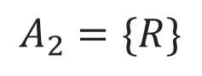

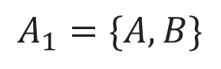


$$L_{1}∪L_{2}$$
$$A_{1}=\{A,B\}$$
$$A_{2}=\{R\}$$
$$AP$$
$$CP$$
As per theorem stated earlier, the states which consists A or B or R will be Accepting states in the resultant FA.
0
0
0
$$BQ$$
0
$$CQ$$
1
1
0
0
1
1
$$AR$$
$$CR$$
Accepting States $A=\{AP, AR, BQ, CR\}$

Slide 41







$$L_{1}∩L_{2}$$
$$A_{1}=\{A,B\}$$
$$A_{2}=\{R\}$$
$$AP$$
$$CP$$
Therefore, as per theorem stated earlier, the states which consists (A and R) and (B and R) will be Accepting states in the resultant FA.
0
0
0
$$BQ$$
0
$$CQ$$
1
1
0
0
1
1
$$AR$$
$$CR$$
Accepting States $A=\{AR\}$

Slide 42

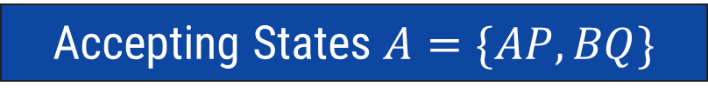





$$L_{1}−L_{2}$$
$$A_{1}=\{A,B\}$$
$$A_{2}=\{R\}$$
$$AP$$
$$CP$$
Therefore, as per theorem stated earlier, the states which consists A or B but should not contain R with them will be Accepting states in the resultant FA.
0
0
0
$$BQ$$
0
$$CQ$$
1
1
0
0
1
1
$$AR$$
$$CR$$
Accepting States $A=\{AP, BQ\}$

Slide 43









Exercise
Draw Finite Automata for following languages:
L1={x/x 11 is not substring of x, x ∈ {0,1}*}
L2={x/x ends with 10, x ∈ {0,1}*}
Draw FA for $L_{1}∪L_{2}$, $L_{1}∩L_{2}$ and $L_{1}−L_{2}$.
0
0,1
0
1
1
0
$$A$$
$$B$$
1
$$C$$
$$P$$
1
$$Q$$
$$R$$
0
1
0
$$M_{1}$$
$$M_{2}$$

Slide 44

Extended Transition Function $δ^{∗}$ for FA
Let $M=(Q,Σ,q_{0},A,δ)$ be an Finite Automata. We define the function
$$δ^{∗}:Q×Σ^{∗}→Q$$
as follows:
For any $q∈Q,δ^{∗}\left(q,∧\right)=q$
For any $q∈Q, y∈Σ^{∗},$ and $a∈Σ$,
$$δ^{∗}\left(q,ya\right)=δ(δ^{∗}\left(q,y\right),a)$$

Slide 45






Example: Extended Transition Function $δ^{∗}$ for FA
Consider FA
Calculate $δ^{∗}(q,abc)$
b
$$δ^{∗}\left(q,∧\right)$$ | $$=q$$
$$δ^{∗}\left(q,ya\right)$$ | $$=δ(δ^{∗}\left(q,y\right),a)$$
$$q$$
a
$$q_{1}$$
$$q_{2}$$
c
$$q_{3}$$
Formula
$$δ^{∗}(q,abc)$$ | $$=$$ | $$δ(δ^{∗}\left(q,ab\right),c)$$
 | $$=$$ | $$δ(δ\left(δ^{∗}\left(q,a\right),b\right),c)$$
 | $$=$$ | $$δ(δ\left(δ^{∗}\left(q,⋀a\right),b\right),c)$$
 | $$=$$ | $$δ(δ(δ\left(δ^{∗}\left(q,⋀\right),a),b\right),c)$$
 | $$=$$ | $$δ(δ(δ\left(q,a),b\right),c)$$
 | $$=$$ | $$δ(δ\left(q_{1},b\right),c)$$
 | $$=$$ | $$δ(q_{2},c)$$
 | $$=$$ | $$q_{3}$$

Slide 46





Exercise
Consider following FA
Calculate $δ^{∗}(q,xy)$
x
y
$$δ^{∗}\left(q,∧\right)$$ | $$=q$$
$$δ^{∗}\left(q,ya\right)$$ | $$=δ(δ^{∗}\left(q,y\right),a)$$
$$q$$
$$q_{1}$$
$$q_{2}$$
Formula

Slide 47

Acceptance by FA
Let $M=(Q,Σ,q_{0},A,δ)$ be an FA. A string $x∈Σ^{∗}$ is accepted by $M$ if $δ^{∗}\left(q_{0},x\right)∈A$. If string is not accepted, we can say it is rejected by $M$. The language accepted by $M$, or the language recognized by $M$, is the set
$$L\left(M\right)=\left\{x∈Σ^{∗}\right| x is accepted by M\}$$
If 𝐿 is any language over $Σ$, $L$ is accepted or recognized by $M$ if and only if $L=L(M)$.

Slide 48

Nondeterministic Finite Automata (NFA)
A nondeterministic finite automaton is a 5-tuple $M=(Q,Σ,q_{0},A,δ)$ where $Q$ and $Σ$ are nonempty finite sets, $q_{0} ε Q$, $A⊆Q$ and
$$δ :Q×Σ→2^{Q}$$
$Q$ is the set of states, $Σ$ is the alphabet, $q_{0}$ is the initial state and $A$ is the set of accepting states.

Slide 49






Example: NFA
$$M=(Q,Σ,q_{0},A,δ)$$
$Q=\{q_{0},q_{1},q_{2},q_{3},q_{4}\}$
$Σ=\{0,1\}$
$q_{0}=q_{0}$
$A=\{q_{4}\}$
$δ$ is defined as
δ | Input
State | $$0$$ | $$1$$
$$q_{0}$$ | $$\{q_{4}\}$$ | $${\{q}_{1},q_{2}\}$$
$$q_{1}$$ | $$∅$$ | $$\{q_{0}\}$$
$$q_{2}$$ | $$∅$$ | $$\{q_{3}\}$$
$$q_{3}$$ | $${\{q}_{0}\}$$ | $$∅$$
$$q_{1}$$
$$q_{4}$$ | $$∅$$ | $$∅$$
1
1
$$q_{0}$$
0
$$q_{4}$$
1
0
$$q_{2}$$
$$q_{3}$$
1

Slide 50

Acceptance by NFA
Let $M= (Q,Ʃ,q0,A,δ)$be an NFA. The string $x ∈Ʃ∗$ is accepted by $M$ if $δ∗(q0, x) ∩ A≠Ø$. The language recognized, or accepted, by $M$ is the set $L(M)$ of all string accepted by $M$. For any language $L ⊆ Ʃ∗, L$ is recognized by $M if L= L(M).$

Slide 51

Nonrecursive Definition of $δ^{∗}$ for NFA
For an NFA $M=\left(Q,Σ,q_{0},A,δ\right)$, and any $p∈Q,δ^{∗}(p,⋀)$ $=\{p\}$. For any $p∈Q$ and any $x=a_{1}a_{2}…a_{n}∈Σ^{∗} \left(with n ≥1\right),{ δ}^{∗}\left(p,x\right)$ is the set of all states $q$ for which there is a sequence of states $p=p_{0},p_{1},…,p_{n−1},p_{n}=q$ satisfying
$$p_{i}∈δ\left(p_{i−1},a_{i}\right) for each i with 1≤i≤n$$

Slide 52

Recursive Definition of $δ^{∗}$ for NFA
Let $M=\left(Q,Σ,q_{0},A,δ\right)$ be an NFA. The function $δ^{∗}:Q×Σ^{∗}→2^{Q}$ is defined as follows.
For any $q∈Q$, $δ^{∗}(q,⋀)$ $=\{q\}$.
For any $q∈Q$, $y∈Σ^{∗}$, and $a∈Σ$,
$$δ^{∗}\left(q,ya\right)=\bigcup_{r∈δ^{∗}(q,y)}{δ(r,a)}$$

Slide 53





Example: Recursive Definition of $δ^{∗}$ in NFA
$M=(Q,Σ,q_{0},A,δ)$
$Q=\{q_{0},q_{1},q_{2},q_{3}\}$
$Σ=\{0,1\}$
$q_{0}=q_{0}$
$A=\{q_{3}\}$
$δ$ is defined as
δ | Input
State | $$0$$ | $$1$$
$$q_{0}$$ | $${\{q}_{o}\}$$ | $${\{q}_{0},q_{1}\}$$
$$q_{1}$$ | $${\{q}_{2}\}$$ | $${\{q}_{2}\}$$
$$q_{2}$$ | $${\{q}_{3}\}$$ | $${\{q}_{3}\}$$
$$q_{3}$$ | $$∅$$ | $$∅$$
0, 1
$$q_{0}$$
1
$$q_{1}$$
0, 1
$$q_{2}$$
0, 1
$$q_{3}$$
NFA

Slide 54










Example: Recursive Definition of $δ^{∗}$ in NFA
$$=\bigcup_{r∈δ^{∗}(q_{0},⋀)}{δ(r,0)}$$
$$δ^{∗}\left(q_{0},0\right)$$
$$δ^{∗}\left(q,∧\right)$$ | $$=q$$
$$δ^{∗}\left(q,ya\right)$$ | $$=\bigcup_{r∈δ^{∗}(q,y)}{δ(r,a)}$$
$$=\bigcup_{r∈\{q_{0}\}}{δ(r,0)}$$
Formula
$$=δ\left(q_{0},0\right)$$
0, 1
$$=\left\{q_{0}\right\}$$
$$q_{0}$$
1
$$q_{1}$$
0, 1
$$q_{2}$$
0, 1
$$q_{3}$$
NFA

Slide 55





Example: Recursive Definition of $δ^{∗}$ in NFA
$$=\bigcup_{r∈δ^{∗}(q_{0},⋀)}{δ(r,1)}$$
$$δ^{∗}\left(q,∧\right)$$ | $$=q$$
$$δ^{∗}\left(q,ya\right)$$ | $$=\bigcup_{r∈δ^{∗}(q,y)}{δ(r,a)}$$
$$δ^{∗}\left(q_{0},1\right)$$
$$=\bigcup_{r∈\{q_{0}\}}{δ(r,1)}$$
Formula
$$=δ\left(q_{0},1\right)$$
0, 1
$$=\left\{q_{0},q_{1}\right\}$$
$$q_{0}$$
1
$$q_{1}$$
0, 1
$$q_{2}$$
0, 1
$$q_{3}$$
NFA

Slide 56




Example: Recursive Definition of $δ^{∗}$ in NFA
$$=\bigcup_{r∈δ^{∗}(q_{0},1)}{δ(r,1)}$$
$$δ^{∗}\left(q,∧\right)$$ | $$=q$$
$$δ^{∗}\left(q,ya\right)$$ | $$=\bigcup_{r∈δ^{∗}(q,y)}{δ(r,a)}$$
$$δ^{∗}\left(q_{0},11\right)$$
$$=\bigcup_{r∈\{q_{0},q_{1}\}}{δ(r,1)}$$
Formula
0, 1
$$=δ\left(q_{0},1\right)∪ δ\left(q_{1},1\right)$$
$$=\left\{q_{0},q_{1}\right\}∪\{q_{2}\}$$
$$q_{0}$$
1
$$q_{1}$$
0, 1
$$q_{2}$$
0, 1
$$q_{3}$$
$$=\left\{q_{0},q_{1},q_{2}\right\}$$
NFA

Slide 57





Example: Recursive Definition of $δ^{∗}$ in NFA
$$=\bigcup_{r∈δ^{∗}(q_{0},0)}{δ(r,1)}$$
$$δ^{∗}\left(q,∧\right)$$ | $$=q$$
$$δ^{∗}\left(q,ya\right)$$ | $$=\bigcup_{r∈δ^{∗}(q,y)}{δ(r,a)}$$
$$δ^{∗}\left(q_{0},01\right)$$
$$=\bigcup_{r∈\{q_{0}\}}{δ(r,1)}$$
Formula
$$=δ\left(q_{0},1\right)$$
0, 1
$$=\left\{q_{0},q_{1}\right\}$$
$$q_{0}$$
1
$$q_{1}$$
0, 1
$$q_{2}$$
0, 1
$$q_{3}$$
NFA

Slide 58









Example: Recursive Definition of $δ^{∗}$ in NFA
$$=\bigcup_{r∈δ^{∗}(q_{0},11)}{δ(r,1)}$$
$$δ^{∗}\left(q_{0},111\right)$$
$$δ^{∗}\left(q,∧\right)$$ | $$=q$$
$$δ^{∗}\left(q,ya\right)$$ | $$=\bigcup_{r∈δ^{∗}(q,y)}{δ(r,a)}$$
$$=\bigcup_{r∈\{q_{0},q_{1},q_{2}\}}{δ(r,1)}$$
Formula
$$=δ\left(q_{0},1\right)∪ δ\left(q_{1},1\right)∪ δ\left(q_{2},1\right)$$
0, 1
$$=\left\{q_{0},q_{1},q_{2},q_{3}\right\}$$
$$=\bigcup_{r∈δ^{∗}(q_{0},01)}{δ(r,1)}$$
$$δ^{∗}\left(q_{0},011\right)$$
$$q_{0}$$
1
$$q_{1}$$
0, 1
$$q_{2}$$
0, 1
$$q_{3}$$
NFA
$$=δ\left(q_{0},1\right)∪ δ\left(q_{1},1\right)$$
$$=\left\{q_{0},q_{1},q_{2}\right\}$$

Slide 59
NFA to FA using subset construction method

Slide 60







Example 1: Conversion from NFA to FA
$$q$$ | $$δ\left(q,a\right)$$ | $$δ\left(q,b\right)$$
1 | {2,3} | {4}
2 | {$φ$} | {4}
3 | {4} | {3}
4 | {$φ$} | $\{φ$}
2
$$δ \left(1,a\right)= \{2,3\}$$
a
b
$$δ\left(1,b\right)= \{4\}$$
1
b
4
$$δ\left(\left\{2,3\right\},a\right)= δ\left(2,a\right) ∪δ(3,a)$$
a
a
$$= \{4\}$$
3
Transition Table
$$δ\left(\left\{2,3\right\},b\right)= δ\left(2,b\right) ∪δ(3,b)$$
b
$$= \{3,4\}$$
NFA
$$δ(4,a)= \{∅\}$$
1
a
2,3
b
3,4
$$δ(4,b)= \{∅\}$$
a
b
4

Slide 61





Example 1: Conversion from NFA to FA
$$q$$ | $$δ\left(q,a\right)$$ | $$δ\left(q,b\right)$$
1 | {2,3} | {4}
2 | {$φ$} | {4}
3 | {4} | {3}
4 | {$φ$} | $\{φ$}
2
$$δ\left(\{3,4\},a\right)=δ\left(3,a\right) ∪δ(4,a)$$
a
b
$$= \{4\}$$
1
b
4
$$δ\left(\left\{3,4\right\},b\right)= δ\left(3,b\right) ∪δ(4,b)$$
$$= \{3\}$$
a
a
3
$$δ(3,a)= \{4\}$$
Transition Table
b
$$δ(3,b)= \{3\}$$
NFA
1
a
2,3
b
3,4
a
a
To define accepting states, the states which contain the accepting states of NFA will be accepting states of final FA.
b
b
4
a
3
b
FA

Slide 62




Example 2: Conversion from NFA to FA
δ | Input
State | $$0$$ | $$1$$
$$q_{0}$$ | $${\{q}_{o}\}$$ | $${\{q}_{0},q_{1}\}$$
$$q_{1}$$ | $${\{q}_{2}\}$$ | $${\{q}_{2}\}$$
$$q_{2}$$ | $${\{q}_{3}\}$$ | $${\{q}_{3}\}$$
$$q_{3}$$ | $$∅$$ | $$∅$$
Transition Table
0, 1
$$q_{0}$$
1
$$q_{1}$$
0, 1
$$q_{2}$$
0, 1
$$q_{3}$$
NFA

Slide 63












Example 2: Conversion from NFA to FA
0, 1
$$q_{0}q_{3}$$
0
$$q_{0}$$
1
$$q_{1}$$
0, 1
$$q_{2}$$
0, 1
$$q_{3}$$
0
$$q_{0}q_{2}$$
1
NFA
0
$$q_{0}$$
1
$$q_{0}q_{1}$$
$$q_{0}q_{1}q_{3}$$
1
$$q_{0}q_{1}q_{2}$$
$$δ\left(\{q_{0}\},0\right)=\{q_{0}\}$$
$$δ\left(\{q_{0}\},1\right)=\{q_{0},q_{1}\}$$
$$δ\left(\{q_{0},q_{1}\},0\right)=δ\left(\left\{q_{0}\right\},0\right)∪δ\left(\left\{q_{1}\right\},0\right)=\left\{q_{0}\right\}∪\left\{q_{2}\right\}=\{q_{0},q_{2}\}$$
$$δ\left(\{q_{0},q_{1}\},1\right)=δ\left(\left\{q_{0}\right\},1\right)∪δ\left(\left\{q_{1}\right\},1\right)=\left\{q_{0},q_{1}\right\}∪\left\{q_{2}\right\}=\{q_{0},q_{1},q_{2}\}$$
$$δ\left(\{q_{0},q_{2}\},0\right)=δ\left(\left\{q_{0}\right\},0\right)∪δ\left(\left\{q_{2}\right\},0\right)=\left\{q_{0}\right\}∪\left\{q_{3}\right\}=\{q_{0},q_{3}\}$$
$$δ\left(\{q_{0},q_{2}\},1\right)=δ\left(\left\{q_{0}\right\},1\right)∪δ\left(\left\{q_{2}\right\},1\right)=\left\{q_{0},q_{1}\right\}∪\left\{q_{3}\right\}=\{q_{0},q_{1},q_{3}\}$$

Slide 64












Example 2: Conversion from NFA to FA
$$δ\left(\{q_{0},q_{1},q_{2}\},0\right)=δ\left(\left\{q_{0}\right\},0\right)∪δ\left(\left\{q_{1}\right\},0\right)∪δ\left(\left\{q_{2}\right\},0\right)= \{q_{0},q_{2},q_{3}\}$$
$$δ\left(\{q_{0},q_{1},q_{2}\},1\right)=δ\left(\left\{q_{0}\right\},1\right)∪δ\left(\left\{q_{1}\right\},1\right)∪δ\left(\left\{q_{2}\right\},1\right)= \{q_{0},q_{1},q_{2},q_{3}\}$$
$$δ\left(\{q_{0},q_{3}\},0\right)=δ\left(\left\{q_{0}\right\},0\right)∪δ\left(\left\{q_{3}\right\},0\right)= \{q_{0}\}$$
$$δ\left(\{q_{0},q_{3}\},1\right)=δ\left(\left\{q_{0}\right\},1\right)∪δ\left(\left\{q_{3}\right\},1\right)= \{q_{0},q_{1}\}$$
0, 1
0
$$q_{0}q_{3}$$
$$q_{0}$$
1
$$q_{1}$$
0, 1
$$q_{2}$$
0, 1
$$q_{3}$$
1
0
0
$$q_{0}q_{2}$$
1
NFA
$$q_{0}q_{1}q_{3}$$
0
$$q_{0}$$
1
$$q_{0}q_{1}$$
$$q_{0}q_{2}q_{3}$$
0
1
$$q_{0}q_{1}q_{2}$$
1
$$q_{0}q_{1}q_{2}q_{3}$$

Slide 65








Example 2: Conversion from NFA to FA
$$δ\left(\{q_{0},q_{1},q_{3}\},0\right)=δ\left(\left\{q_{0}\right\},0\right)∪δ\left(\left\{q_{1}\right\},0\right)∪δ\left(\left\{q_{3}\right\},0\right)= \{q_{0},q_{2}\}$$
$$δ\left(\{q_{0},q_{1},q_{3}\},1\right)=δ\left(\left\{q_{0}\right\},1\right)∪δ\left(\left\{q_{1}\right\},1\right)∪δ\left(\left\{q_{3}\right\},1\right)= \{q_{0},q_{1},q_{2}\}$$
$$δ\left(\{q_{0},q_{2},q_{3}\},0\right)=δ\left(\left\{q_{0}\right\},0\right)∪δ\left(\left\{q_{2}\right\},0\right)∪δ\left(\left\{q_{3}\right\},0\right)= \{q_{0},q_{3}\}$$
0, 1
$$δ\left(\{q_{0},{q_{2},q}_{3}\},1\right)=δ\left(\left\{q_{0}\right\},1\right)∪δ\left(\left\{q_{2}\right\},1\right)∪δ\left(\left\{q_{3}\right\},1\right)= \{q_{0},q_{1},q_{3}\}$$
0
$$q_{0}q_{3}$$
$$q_{0}$$
1
$$q_{1}$$
0, 1
$$q_{2}$$
0, 1
$$q_{3}$$
1
0
$$q_{0}q_{2}$$
NFA
0
$$q_{0}q_{2}$$
1
$$q_{0}q_{1}q_{3}$$
0
0
0
$$q_{0}$$
1
$$q_{0}q_{1}$$
$$q_{0}$$
$$q_{0}q_{1}$$
1
1
$$q_{0}q_{2}q_{3}$$
0
1
$$q_{0}q_{1}q_{2}$$
$$q_{0}q_{1}q_{2}$$
1
$$q_{0}q_{1}q_{2}q_{3}$$

Slide 66








Example 2: Conversion from NFA to FA
$$δ\left(\{q_{0},q_{1},q_{2},q_{3}\},0\right)=δ\left(\left\{q_{0}\right\},0\right)∪δ\left(\left\{q_{1}\right\},0\right)∪δ\left(\left\{q_{2}\right\},0\right)∪δ\left(\left\{q_{3}\right\},0\right)= \{q_{0},q_{2},q_{3}\}$$
$$δ\left(\{q_{0},q_{1},q_{2},q_{3}\},1\right)=δ\left(\left\{q_{0}\right\},1\right)∪δ\left(\left\{q_{1}\right\},1\right)∪δ\left(\left\{q_{2}\right\},1\right)∪δ\left(\left\{q_{3}\right\},1\right)= \{q_{0},q_{1},q_{2},q_{3}\}$$
0, 1
0
$$q_{0}q_{3}$$
$$q_{0}$$
1
$$q_{1}$$
0, 1
$$q_{2}$$
0, 1
$$q_{3}$$
1
0
NFA
0
$$q_{0}q_{2}$$
1
$$q_{0}q_{1}q_{3}$$
0
0
0
$$q_{0}$$
1
$$q_{0}q_{1}$$
1
1
$$q_{0}q_{2}q_{3}$$
0
1
To define accepting states, the states which contain the accepting states of NFA will be accepting states of final FA.
$$q_{0}q_{1}q_{2}$$
1
0
1
$$q_{0}q_{1}q_{2}q_{3}$$
FA

Slide 67

Nondeterministic Finite Automata with $⋀$-Transitions
A nondeterministic finite automaton with $⋀$-transitions (NFA- $⋀$) is a 5-tuple $M=(Q,Σ,q_{0},A,δ)$ where $Q$ and $Σ$ are finite sets, $q_{0} ε Q$, $A⊆Q$ and
$$δ :Q×(Σ∪\{⋀\})→2^{Q}$$

Slide 68

Nonrecursive Definition of $δ^{∗}$ for NFA- $⋀$
For an NFA - $⋀$ $M=(Q,Σ,q_{0},A,δ)$, states $p,q ∈Q$, and a string $x=a_{1}a_{2}…a_{n}∈Σ^{∗},$ we will say $M$ moves from $p$ to $q$ by a sequence of transition corresponding to $x$ if there exist an integer $m≥n$, a sequence $b_{1},b_{2},…b_{m}∈Σ ⋃\{⋀\}$ satisfying $b_{1}b_{2}…b_{m}=x$, and a sequence of states $p=p_{0},p_{1},…,p_{m}=q$ so that for each $i$ with $1≤i≤m$, $p_{i}∈δ(p_{i−1},b_{i})$.

Slide 69

$⋀$-closure of a set of States
Let $M=(Q,Σ,q_{0},A,δ)$ be an NFA-$⋀$, and let $S$ be any subset of $Q$. The $⋀$-closure of $S$ is the set $⋀$($S$) defined as follows:
Every element of $S$ is an element of $⋀\left(S\right).$
For any $q∈⋀(S)$, every element of $δ(q,⋀$) is in $⋀\left(S\right).$
No other elements of $Q$ are in $⋀(S)$.

Slide 70














Applying Definitions of $^(S)$
0
1
$$Λ\left(\left\{q_{0}\right\}\right)=$$
$\{$
$$q_{0},$$
$$p,$$
$$t$$
$\}$
$$p$$
1
$$r$$
0
$$s$$
^
^
$${ q}_{0}$$
^
$$w$$
^
$$t$$
0
$$u$$
0
$$v$$
^
1
0

Slide 71








Applying Definitions of $^(S)$
0
1
$$s,$$
$$w,$$
$$q_{0},$$
$$p,$$
$$t$$
$$Λ\left(\left\{s\right\}\right)=$$
$\{$
$\}$
$$p$$
1
$$r$$
0
$$s$$
^
^
$${ q}_{0}$$
^
$$w$$
^
$$t$$
0
$$u$$
0
$$v$$
^
1
0

Slide 72

Recursive Definition of $δ^{∗}$ for NFA- $⋀$
Let $M=\left(Q,Σ,q_{0},A,δ\right)$ be an NFA- $⋀$. The extended transition function $δ^{∗}:Q×Σ^{∗}→2^{Q}$ is defined as follows.
For any $q∈Q, δ^{∗}(q,⋀)$ $=⋀\left(\left\{q\right\}\right).$
For any $q∈Q, y∈Σ^{∗},$and $a∈Σ$,
$$δ^{∗}\left(q,ya\right)=⋀(\bigcup_{r∈δ^{∗}(q,y)}{δ(r,a)})$$
A string $x$ is accepted by $M$ if $δ^{∗}(q_{0},x)⋂A≠φ$. The language recognized by $M$ is the set $L(M)$ of all strings accepted by $M$.

Slide 73




Applying Definition of $δ^{∗}$
0
1
$$δ^{∗}\left(q_{0}, Λ\right)$$
$=Λ(\{q_{0}\})$
$$p$$
1
$$r$$
0
$$s$$
$=\{q_{0},p,t\}$
^
$${ q}_{0}$$
^
$$w$$
^
^
$$t$$
0
$$u$$
0
$$v$$
^
1
0
$$δ^{∗}\left(q,∧\right)$$ | $$=^\{q\}$$
$$δ^{∗}\left(q,ya\right)$$ | $$=^(\bigcup_{r∈δ^{∗}\left(q,y\right)}{δ\left(r,a\right)})$$

Slide 74















Applying Definition of $δ^{∗}$
0
1
$$δ^{∗}\left(q_{0}, Λ\right)$$
$=Λ(\{q_{0}\})$
$=\{q_{0},p,t\}$
$$p$$
1
$$r$$
0
$$s$$
^
^
$$δ^{∗}\left(q_{0}, 0\right)$$
$$= Λ\left(\bigcup_{r∈δ^{∗}\left(q_{0}, Λ\right)}{δ\left(r,0\right)}\right)$$
$${ q}_{0}$$
^
$$w$$
$$= Λ\left(\bigcup_{r∈\{q_{0},p,t\}}{δ\left(r,0\right)}\right)$$
^
$$t$$
0
$$u$$
0
$$v$$
^
1
0
$= Λ(δ\left(q_{0},0\right) ∪δ\left(p,0\right) ∪δ\left(t,0\right))$
$= Λ(φ ∪\{p\} ∪\{u\})$
$$δ^{∗}\left(q,∧\right)$$ | $$=^\{q\}$$
$$δ^{∗}\left(q,ya\right)$$ | $$=^(\bigcup_{r∈δ^{∗}\left(q,y\right)}{δ\left(r,a\right)})$$
$= Λ(\{p,u\})$
$= \{p,u\}$

Slide 75


Applying Definition of $δ^{∗}$
0
1
$$δ^{∗}\left(q_{0}, 01\right)= Λ\left(\bigcup_{r∈δ^{∗}\left(q_{0}, 0\right)}{δ\left(r,1\right)}\right)$$
$$p$$
1
$$r$$
0
$$s$$
$= Λ(δ\left(p,1\right) ∪δ\left(u,1\right))$
^
^
$= Λ(\{r\})$
$${ q}_{0}$$
^
$$w$$
$= \{r\}$
$$δ^{∗}\left(q_{0}, 010\right) = Λ\left(\bigcup_{r∈δ^{∗}\left(q_{0}, 01\right)}{δ\left(r,0\right)} \right)$$
^
$$t$$
0
$$u$$
0
$$v$$
^
1
0
$= Λ(δ\left(r,0\right))$
$$δ^{∗}\left(q,∧\right)$$ | $$=^\{q\}$$
$$δ^{∗}\left(q,ya\right)$$ | $$=^(\bigcup_{r∈δ^{∗}\left(q,y\right)}{δ\left(r,a\right)})$$
$= Λ(\{s\})$
$= \{s,w,q_{0},p,t\}$

Slide 76
NFA-^ to FA

Slide 77

NFA-^ to FA
NFA - $⋀$
NFA
FA
Step-1
Step-2
0
C
C
1
0
0
ABCD
BD
0
0
0
1
1
0
0
0
0
1
A
^
B
^
D
A
B
D
A
1
0
0
CD
0
0
D
0

Slide 78

Conversion from NFA- $^$ to FA
$$q$$ | $$δ\left(q,^\right)$$ | $$δ\left(q,0\right)$$ | $$δ\left(q,1\right)$$
A | {B} | {A} | $$φ$$
B | {D} | {C} | $$φ$$
C | $$φ$$ | $$φ$$ | {B}
D | $$φ$$ | {D} | $$φ$$
C
0
0
0
1
A
^
B
^
D
NFA ^
Transition Table

Slide 79










Conversion from NFA- $^$ to FA
C
$$δ^{∗}\left(q,∧\right)$$ | $$=^\{q\}$$
$$δ^{∗}\left(q,ya\right)$$ | $$=^(\bigcup_{r∈δ^{∗}\left(q,y\right)}{δ\left(r,a\right)})$$
Step 1: To convert NFA - ^ to NFA
$$δ^{∗}\left(A,^\right)$$
$$=Λ\left\{A\right\}=\{A,B,D\}$$
0
$$=Λ\left(\bigcup_{r∈δ^{∗}\left(A, ^\right)}{δ\left(r,0\right)} \right)$$
0
Formula
$$δ^{∗}\left(A,0\right)$$
A
0
B
D
$$=Λ\left(\bigcup_{r∈\{A,B,D\}}{δ\left(r,0\right)} \right)$$
0
$$=Λ(δ\left(A,0\right)∪δ\left(B,0\right)∪δ\left(D,0\right))$$
$$=Λ(\left\{A,C,D\right\})$$
$$q$$ | $$δ^{∗}\left(q,0\right)$$ | $$δ^{∗}\left(q,1\right)$$
$$A$$ | $$\{A,B,C,D\}$$ | $$φ$$
$$B$$ | $$\{C,D\}$$ | $$φ$$
$$C$$ | $$φ$$ | $$\{B,D\}$$
$$D$$ | $$\{D\}$$ | $$φ$$
$$=\{A,B,C,D\}$$
C
0
0
0
1
A
^
B
^
D
NFA ^

Slide 80





Conversion from NFA- $^$ to FA
C
$$δ^{∗}\left(q,∧\right)$$ | $$=^\{q\}$$
$$δ^{∗}\left(q,ya\right)$$ | $$=^(\bigcup_{r∈δ^{∗}\left(q,y\right)}{δ\left(r,a\right)})$$
$$=Λ\left(\bigcup_{r∈δ^{∗}\left(A, ^\right)}{δ\left(r,1\right)} \right)$$
$$δ^{∗}\left(A,1\right)$$
0
0
$$=Λ\left(\bigcup_{r∈\{A,B,D\}}{δ\left(r,1\right)} \right)$$
Formula
A
0
B
D
$$=Λ\left(δ\left(A,1\right)\right)∪δ\left(B,1\right)∪δ\left(D,1\right)$$
0
$$=Λ(φ)$$
$$=φ$$
$$q$$ | $$δ^{∗}\left(q,0\right)$$ | $$δ^{∗}\left(q,1\right)$$
$$A$$ | $$\{A,B,C,D\}$$ | $$φ$$
$$B$$ | $$\{C,D\}$$ | $$φ$$
$$C$$ | $$φ$$ | $$\{B,D\}$$
$$D$$ | $$\{D\}$$ | $$φ$$
C
0
0
0
1
A
^
B
^
D
NFA ^

Slide 81









Conversion from NFA- $^$ to FA
C
$$δ^{∗}\left(q,∧\right)$$ | $$=^\{q\}$$
$$δ^{∗}\left(q,ya\right)$$ | $$=^(\bigcup_{r∈δ^{∗}\left(q,y\right)}{δ\left(r,a\right)})$$
$$δ^{∗}\left(B,^\right)$$
$$=Λ\left\{B\right\}=\{B,D\}$$
$$=Λ\left(\bigcup_{r∈δ^{∗}\left(B, ^\right)}{δ\left(r,0\right)} \right)$$
0
0
$$δ^{∗}\left(B,0\right)$$
0
Formula
A
0
B
0
D
$$=Λ\left(\bigcup_{r∈\{B,D\}}{δ\left(r,0\right)} \right)$$
0
$$=Λ(δ\left(B,0\right)∪δ\left(D,0\right))$$
$$=Λ(\left\{C,D\right\})$$
$$q$$ | $$δ^{∗}\left(q,0\right)$$ | $$δ^{∗}\left(q,1\right)$$
$$A$$ | $$\{A,B,C,D\}$$ | $$φ$$
$$B$$ | $$\{C,D\}$$ | $$φ$$
$$C$$ | $$φ$$ | $$\{B,D\}$$
$$D$$ | $$\{D\}$$ | $$φ$$
$$=\{C,D\}$$
C
0
0
0
1
A
^
B
^
D
NFA ^

Slide 82




Conversion from NFA- $^$ to FA
C
$$δ^{∗}\left(q,∧\right)$$ | $$=^\{q\}$$
$$δ^{∗}\left(q,ya\right)$$ | $$=^(\bigcup_{r∈δ^{∗}\left(q,y\right)}{δ\left(r,a\right)})$$
$$=Λ\left(\bigcup_{r∈δ^{∗}\left(B, ^\right)}{δ\left(r,1\right)} \right)$$
$$δ^{∗}\left(B,1\right)$$
0
0
0
Formula
$$=Λ\left(\bigcup_{r∈\{B,D\}}{δ\left(r,1\right)} \right)$$
A
0
B
0
D
$$=Λ(δ\left(B,1\right)∪δ\left(D,1\right))$$
0
$$=Λ(φ)$$
$$=φ$$
$$q$$ | $$δ^{∗}\left(q,0\right)$$ | $$δ^{∗}\left(q,1\right)$$
$$A$$ | $$\{A,B,C,D\}$$ | $$φ$$
$$B$$ | $$\{C,D\}$$ | $$φ$$
$$C$$ | $$φ$$ | $$\{B,D\}$$
$$D$$ | $$\{D\}$$ | $$φ$$
C
0
0
0
1
A
^
B
^
D
NFA ^

Slide 83








Conversion from NFA- $^$ to FA
C
$$δ^{∗}\left(q,∧\right)$$ | $$=^\{q\}$$
$$δ^{∗}\left(q,ya\right)$$ | $$=^(\bigcup_{r∈δ^{∗}\left(q,y\right)}{δ\left(r,a\right)})$$
$$δ^{∗}\left(C,^\right)$$
$$=Λ\left\{C\right\}=\{C\}$$
$$=Λ\left(\bigcup_{r∈δ^{∗}\left(C, ^\right)}{δ\left(r,0\right)} \right)$$
0
0
$$δ^{∗}\left(C,0\right)$$
0
Formula
$$=Λ\left(\bigcup_{r∈\{C\}}{δ\left(r,0\right)} \right)$$
A
0
B
0
D
0
$$=Λ(δ\left(C,0\right))$$
$$=Λ(φ)$$
$$q$$ | $$δ^{∗}\left(q,0\right)$$ | $$δ^{∗}\left(q,1\right)$$
$$A$$ | $$\{A,B,C,D\}$$ | $$φ$$
$$B$$ | $$\{C,D\}$$ | $$φ$$
$$C$$ | $$φ$$ | $$\{B,D\}$$
$$D$$ | $$\{D\}$$ | $$φ$$
$$=φ$$
C
0
0
0
1
A
^
B
^
D
NFA ^

Slide 84





Conversion from NFA- $^$ to FA
C
$$δ^{∗}\left(q,∧\right)$$ | $$=^\{q\}$$
$$δ^{∗}\left(q,ya\right)$$ | $$=^(\bigcup_{r∈δ^{∗}\left(q,y\right)}{δ\left(r,a\right)})$$
$$=Λ\left(\bigcup_{r∈δ^{∗}\left(C, ^\right)}{δ\left(r,1\right)} \right)$$
$$δ^{∗}\left(C,1\right)$$
0
0
0
1
1
$$=Λ\left(\bigcup_{r∈\{C\}}{δ\left(r,1\right)} \right)$$
Formula
A
0
B
0
D
$$=Λ(δ\left(C,1\right))$$
0
$$=Λ(\{B\})$$
$$=\{B,D\}$$
$$q$$ | $$δ^{∗}\left(q,0\right)$$ | $$δ^{∗}\left(q,1\right)$$
$$A$$ | $$\{A,B,C,D\}$$ | $$φ$$
$$B$$ | $$\{C,D\}$$ | $$φ$$
$$C$$ | $$φ$$ | $$\{B,D\}$$
$$D$$ | $$\{D\}$$ | $$φ$$
C
0
0
0
1
A
^
B
^
D
NFA ^

Slide 85









Conversion from NFA- $^$ to FA
C
$$δ^{∗}\left(q,∧\right)$$ | $$=^\{q\}$$
$$δ^{∗}\left(q,ya\right)$$ | $$=^(\bigcup_{r∈δ^{∗}\left(q,y\right)}{δ\left(r,a\right)})$$
$$δ^{∗}\left(D,^\right)$$
$$=Λ\left\{D\right\}=\{D\}$$
$$=Λ\left(\bigcup_{r∈δ^{∗}\left(D, ^\right)}{δ\left(r,0\right)} \right)$$
0
0
$$δ^{∗}\left(D,0\right)$$
0
1
1
Formula
0
$$=Λ\left(\bigcup_{r∈\{D\}}{δ\left(r,0\right)} \right)$$
A
0
B
0
D
0
$$=Λ(δ\left(D,0\right))$$
$$=Λ(\{D\})$$
$$q$$ | $$δ^{∗}\left(q,0\right)$$ | $$δ^{∗}\left(q,1\right)$$
$$A$$ | $$\{A,B,C,D\}$$ | $$φ$$
$$B$$ | $$\{C,D\}$$ | $$φ$$
$$C$$ | $$φ$$ | $$\{B,D\}$$
$$D$$ | $$\{D\}$$ | $$φ$$
$$=\{D\}$$
C
0
0
0
1
A
^
B
^
D
NFA ^

Slide 86







Conversion from NFA- $^$ to FA
$$δ^{∗}\left(q,∧\right)$$ | $$=^\{q\}$$
$$δ^{∗}\left(q,ya\right)$$ | $$=^(\bigcup_{r∈δ^{∗}\left(q,y\right)}{δ\left(r,a\right)})$$
$$=Λ\left(\bigcup_{r∈δ^{∗}\left(D, ^\right)}{δ\left(r,1\right)} \right)$$
C
$$δ^{∗}\left(D,1\right)$$
0
0
0
Formula
$$=Λ\left(\bigcup_{r∈\{D\}}{δ\left(r,1\right)} \right)$$
0
1
1
A
0
B
0
D
$$=Λ(δ\left(D,1\right))$$
Resulting NFA
$$=Λ(φ)$$
0
$$q$$ | $$δ^{∗}\left(q,0\right)$$ | $$δ^{∗}\left(q,1\right)$$
$$A$$ | $$\{A,B,C,D\}$$ | $$φ$$
$$B$$ | $$\{C,D\}$$ | $$φ$$
$$C$$ | $$φ$$ | $$\{B,D\}$$
$$D$$ | $$\{D\}$$ | $$φ$$
$$=φ$$
{
C
Accepting State
=
$A∪\left\{q_{0}\right\}$if $Λ\left(\left\{q_{0}\right\}\right)∩A≠φ$ in $M$
$A$ otherwise
0
0
0
1
A
^
B
^
D
NFA ^
Transition table of NFA

Slide 87






Conversion from NFA- $^$ to FA
Step 2: To convert NFA to FA
$$q$$ | $$δ^{∗}\left(q,0\right)$$ | $$δ^{∗}\left(q,1\right)$$
$$A$$ | $$\{A,B,C,D\}$$ | $$φ$$
$$B$$ | $$\{C,D\}$$ | $$φ$$
$$C$$ | $$φ$$ | $$\{B,D\}$$
$$D$$ | $$\{D\}$$ | $$φ$$
$$δ\left(\{A\},0\right)= \{A,B,C,D\}$$
$$δ\left(\{A\},1\right)= φ$$
$$δ\left(\{A,B,C,D\},0\right)=(δ\left(A,0\right) ∪δ\left(B,0\right) ∪δ\left(C,0\right) ∪δ\left(D,0)\right)$$
$= \{A,B,C,D\}$ $∪$ {C,D} $∪$ {$φ$}$∪$ {D} = $\{A,B,C,D\}$
$$δ\left(\{A,B,C,D\},1\right)=(δ\left(A,1\right) ∪δ\left(B,1\right) ∪δ\left(C,1\right) ∪δ\left(D,1)\right)$$
Transition table of NFA
$$= \{B,D\}$$
$$δ\left(\{B,D\},0\right)=(δ\left(B,0\right) ∪δ\left(D,0)\right)$$
0
$$= \{C,D\}$$
ABCD
1
BD
0
$$δ\left(\{B,D\},1\right)=(δ\left(B,1\right) ∪δ\left(D,1)\right)$$
0
CD
$$=φ$$
A

Slide 88




Conversion from NFA- $^$ to FA
$$δ\left(\{C,D\},0\right)=(δ\left(C,0\right) ∪δ\left(D,0)\right)$$
$$q$$ | $$δ^{∗}\left(q,0\right)$$ | $$δ^{∗}\left(q,1\right)$$
$$A$$ | $$\{A,B,C,D\}$$ | $$φ$$
$$B$$ | $$\{C,D\}$$ | $$φ$$
$$C$$ | $$φ$$ | $$\{B,D\}$$
$$D$$ | $$\{D\}$$ | $$φ$$
$$= \{D\}$$
$$δ\left(\{C,D\},1\right)=(δ\left(C,1\right) ∪δ\left(D,1)\right)$$
0
$$= \{B,D\}$$
$$δ\left(\{D\},0\right)= \{D\}$$
ABCD
1
BD
0
Transition table of NFA
$$δ\left(\{D\},1\right)= φ$$
0
1
A
CD
FA
0
D
0

Slide 89
Exercise: Conversion from NFA- $^$ to FA
Convert following NFA-^ to FA
Q | δ (q, Λ) | δ (q,0) | δ (q,1)
→A | {B,D} | {A} | Ø
B | Ø | {C} | {E}
C | Ø | Ø | {B}
D | Ø | {E} | {D}
* E | Ø | Ø | Ø

Slide 90
Kleene’s Theorem Part-1

Slide 91

Kleene’s Theorem Part-1
Statement: Any regular language can be accepted by a finite automaton.
Proof:
On the basis of statement, $L$can be recognized by FA, NFA and NFA-^. It is sufficient to so that every regular language can be accepted by NFA- ^.
Set of regular language over alphabet $Σ$ contains the basic languages Ø, {^} and $\left\{a\right\}(a∈Σ)$ to be closed under operation of union, concatenation, and Kleene*.
This allows us to prove using structural induction that every regular language over $Σ$ can be accepted by an NFA-^.
The basis step of the proof is to show that the three basic languages can be accepted by NFA- ^s.
The induction hypothesis is that $L_{1}$ and $L_{2}$ are languages that can be accepted by NFA- ^s and the induction step is to show that $L_{1}∪L_{2},L_{1}L_{2}$ and $L_{1}^{∗}$ can also be.

Slide 92

Kleene’s Theorem Part-1
NFA-^ for the three basic languages is shown below.
Now, suppose that $L_{1}$ and $L_{2}$ are recognized by the NFA-^s $M_{1}$ and $M_{2}$, respectively, where for both $i$=1 and $i$=2,
$$M_{i}=(Q_{i},Σ,q_{i},A_{i},δ_{i})$$
By renaming states if necessary, we may assume that $Q_{1}$ ∩ $Q_{2}$ = Ø. We will construct NFA-^s $M_{u}$, $M_{c}$, and $M_{k}$ recognizing the language $L_{1}$ U $L_{2}$, $L_{1}L_{2}$, and $L_{1}^{∗}$, respectively.
a
Ø
{^}
{a}

Slide 93








Kleene’s Theorem Part-1
Construction of $M_{u}=\left(Q_{u},Σ,q_{u},A_{u},δ_{u}\right)$
Let $q_{u}$ be a new state, not in either $Q_{1}$ or $Q_{2}$ and let
$Q_{u}$ = $Q_{1}$ U $Q_{2}$ U {$q_{u}$}
$A_{u}$ = $A_{1}$ U $A_{2}$
$${ f}_{1}$$
$${ q}_{1}$$
^
$$f_{1}^{′}$$
$${ q}_{u}$$
$${ f}_{2}$$
^
$${ q}_{2}$$
$$f_{2}^{′}$$

Slide 94








Kleene’s Theorem Part-1
Now, we define $δ_{u}$ so that $M_{u}$ can move from its initial state to either $q_{1}$ or $q_{2}$ by a ^ transition, and then make exactly the same moves that the respective $M_{i}$ would.
Formally we define:
$δ_{u}\text{(}q_{u}\text{,^) = \{}q_{1}\text{, }q_{2}\text{\}}$
$δ_{u}(q_{u},a)$ = Ø for every $a∈Σ$
and for each $q$ ∈ $Q_{1}$ U $Q_{2}$ and $a$ ∈ $Σ$ U {^},
$δ_{u}\left(q_{u},a\right)=$ $δ_{1}(q,a)$ if $q∈Q_{1}$
$δ_{u}\left(q_{u},a\right)=δ_{2}(q,a)$ if $q∈Q_{2}$
For either value of $i$, if $x∈L_{i}$, then $M_{u}$ can process 𝑥 by moving to $q_{i}$ on a ^-transition and then executing the moves that cause $M_{i}$ to accept 𝑥.
On the other hand, if 𝑥 is accepted by $M_{u}$, there is a sequence of transition corresponding to 𝑥, starting at $q_{u}$ and ending at an element of $A_{1}$ or $A_{2}$.
The first of these transitions must be a ^-transition from $q_{u}$ to either $q_{1}$or $q_{2}$, since there are no other transition from $q_{u}$.
Thereafter, since $Q_{1}$ ∩ $Q_{2}$ = Ø, either all the transition are between of $Q_{1}$ or all are between elements of $Q_{2}$. It follow that 𝑥 must be accepted by either $M_{1}$ or $M_{2}$.
$${ f}_{1}$$
$${ q}_{1}$$
^
$$f_{1}^{′}$$
$${ q}_{u}$$
$${ f}_{2}$$
^
$${ q}_{2}$$
$$f_{2}^{′}$$

Slide 95







Kleene’s Theorem Part-1
Construction of $M_{c}$= ($Q_{c}$, $Σ$, $q_{c}$, $A_{c}$, $δ_{c}$)
Let $Q_{c}$ = $Q_{1}$ U $Q_{2}$, $q_{c}$=$q_{1}$, and $A_{c}$ = $A_{2}$. The transition will include all those of $M_{1}$ and $M_{2}$ as well as a $⋀$ - transition from each state in $A_{1}$ to $q_{2}$.
In other words, for any $q$ not in $A_{1}$, and $α∈Σ∪\{⋀\}$, $δ_{c}(q,α)$ is defined to be either $δ_{1}$(q,a) or $δ_{2}$(q,a), depending on whether $q$ is in $Q_{1}$ and $Q_{2}$.
$${ f}_{1}$$
$${ f}_{2}$$
^
$${ q}_{c} {=q}_{1}$$
$${ q}_{2}$$
$$f_{1}^{′}$$
^
$$f_{2}^{′}$$

Slide 96

Kleene’s Theorem Part-1
For $q∈A_{1}$,
$δ_{c}\left(q,a\right)=δ_{1}(q,a)$ for every $a∈Σ$, and $δ_{c}\left(q,⋀\right)=δ_{1}(q,⋀)$ U {$q_{2}$}
On an input string $x_{1}x_{2}$, where $x_{i}$ ∈ $L_{i}$ for both value of $i$, $M_{c}$ can process $x_{1}$, arriving at a state $A_{1}$; jump from this state to $q_{2}$ by a $⋀$- transition; and then process $x_{2}$the way $M_{2}$would, so that $x_{1}x_{2}$ is accepted.
Conversely, if $x$ is accepted by $M_{c}$, there is a sequence of transition corresponding to $x$ that begins at $q_{1}$ and ends at an element of $A_{2}$.
One of them must therefore be from an element of $Q_{1}$ to an element of $Q_{2}$, and according to the definition of$δ_{c}$, this can only be a $⋀$- transition from an element of $A_{1}$ to $q_{2}$. Because $Q_{1}$ ∩ $Q_{2}$= Ø, all the previous transition are between elements of $Q_{1}$ and all the subsequent ones are between elements of $Q_{2}$.
It follows that ${x=x}_{1}∧x_{2}=x_{1}x_{2}$, where $x_{1}$ is accepted by $M_{1}$ and $x_{2}$ is accepted by $M_{2}$; in other words, ${x∈L}_{1}L_{2}$.

Slide 97





Kleene’s Theorem Part-1
Construction of $M_{k}$= ($Q_{k}$, $Σ$, $q_{k}$, $A_{k}$, $δ_{k}$)
Let $q_{k}$ be a new state not in $Q_{1}$ and let $Q_{k}$= $Q_{1}$ U {$q_{k}$} and $A_{k}=\{q_{k}\}$.
Once again all the transitions of $M_{1}$ will be allowed in $M_{k}$, but in addition there is a $⋀$- transition from $q_{k}$ to $q_{1}$ and there is a $⋀$-transition from each elements of $A_{1}$ to $q_{k}$.
$${ q}_{1}$$
^
$${ q}_{k}$$
^
$${ f}_{1}$$
$$f_{1}^{′}$$
^

Slide 98

Kleene’s Theorem Part-1
More precisely,
$δ_{k}(q_{k},⋀)$ = $\{q_{1}\}$ and $δ_{k}\left(q_{k},a\right)=$ Ø for $a∈Σ$
For $q∈Q_{1}$ and $α∈Σ∪\{⋀\}$, $δ_{k}\left(q,α\right)=δ_{1}\left(q,α\right)$ unless $q∈A_{1}$ and $α$ = $⋀$.
For $q∈A_{1}$, $δ_{k}\left(q,⋀\right)=δ_{1}\left(q,⋀\right)$ $∪{\{q}_{k}\}$.
Suppose $x∈L_{1}^{∗}$. If $x=⋀$ then clearly $x$ is accepted by $M_{k}$. Otherwise, for some $m≥1, x=x_{1}x_{2}…x_{m},$ where$x_{i}∈L_{1}$ for each $i$, $M_{k}$ can move from $q_{k}$ to $q_{1}$ by a $⋀$- transition; for each $i$, $M_{k}$ moves from $q_{1}$ to an element $f_{i}$ of $A_{1}$ by a sequence of transition corresponding to $x_{i}$; and for each $i$, $M_{k}$ then moves from $f_{i}$ back to $q_{k}$ by a $⋀$- transition.
It follows that $(⋀ x_{1}⋀)(⋀ x_{2}⋀)$…$(⋀ x_{m}⋀)$= $x$ is accepted by $M_{k}$.
On the other hand, if $x$ is accepted by $M_{k}$, there is a sequence of transition corresponding to $x$ that begins and ends at $q_{k}$. Since the only transition from $q_{k}$ is a $⋀$ - transition to $q_{1}$, and the only transition to $q_{k}$ are $⋀$- transition from elements of $A_{1}$, $x$ can be decomposed in the form
$x=(⋀ x_{1}⋀)(⋀ x_{2}⋀)$…$(⋀ x_{m}⋀)$
where, for each $i$, there is a sequence of transitions corresponding to $x_{i}$ from $q_{1}$ to an element of $A_{1}$. Therefore, $x∈L_{1}^{∗}$.
Since we have constructed an NFA - $⋀$ recognizing $L$ in each of the three cases, the proof is complete.

Slide 99
Application of Kleene’s Theorem

Slide 100



Regular expression to NFA-^ (Application of Kleene’s Theorem)
Union
Concatenation
Kleene(*)
Convert ${\left(aa+b\right)}^{∗}$ to NFA-^
a
^
a
b

Slide 101
Regular expression to NFA-^ (Application of Kleene’s Theorem)
Union
Concatenation
Kleene(*)
Convert ${\left(aa+b\right)}^{∗}$ to NFA-^
^
a
^
a
^
^
b
^
^

Slide 102
Regular expression to NFA-^ (Application of Kleene’s Theorem)
Union
Concatenation
Kleene(*)
Convert ${\left(00+1\right)}^{∗}{(10)}^{∗}$ to NFA-^
0
^
0
1

Slide 103
Regular expression to NFA-^ (Application of Kleene’s Theorem)
Union
Concatenation
Kleene(*)
Convert ${\left(00+1\right)}^{∗}{(10)}^{∗}$to NFA-^
^
0
^
0
^
^
1
^
^

Slide 104
Regular expression to NFA-^ (Application of Kleene’s Theorem)
Convert ${\left(00+1\right)}^{∗}{(10)}^{∗}$to NFA-^
^
0
^
0
^
^
1
^
^
^
^
^
1
^
0

Slide 105
Exercise: RE to NFA-^
00
00+1
(00+1)*
(0+1)*
(111)*
(10+01)*
(0+1)*(11+00)*11
(10+110)*(0+1)*1
(00+1)*(10)*
(a+b)(a+b)*
(aab)*b*(a+b)*

Slide 106
Finite Automata with Output

Slide 107
Finite automata with output
Finite automata has limited capability of either accepting a string or rejecting a string. Acceptance of string was based on the reachability of a machine from starting state to final state.
Finite automata with output do not have a final state.
Machine generates output on every input.
There are two types of automata with outputs:
Moore machine
Mealy machine

Slide 108




Moore machine & Mealy Machine
FA with Output
Moore Machine
Mealy Machine
$$M_{0}=(Q,Σ,Δ,δ,λ^{′},q_{0})$$
$$Output is associated with state$$
$$Output is associated with transition$$
$Q$ : set of states
$Σ$ : input symbols
$Δ$ : output symbols
$δ$ : Transition function
$λ^{′}$: output function
$q_{0}$ : initial state
a
b
a|1
b|0
X,1
b
Y,0
X
b|0
Y
a
a|1

Slide 109

Moore Machine
Mathematically Moore machine is a six tuple machine and defined as
$$M_{0}=(Q,Σ,Δ,δ,λ^{′},q_{0})$$
where,
$Q$ : a nonempty finite set of states in $M_{0}$
$Σ$ : a nonempty finite set of input symbols
$Δ$ : a nonempty finite set of outputs
$δ$ : Transition function which takes two arguments as in finite automata, one is input state and other is input symbol. The output of this function is a single state.
$λ^{′}$: it is a mapping function which maps $Q$ to $Δ$, giving the output associated with each state.
$q_{0}$ : the initial state of $M_{0}$ and $q_{0}$∈ $Q$

Slide 110
Example: Moore Machine
Design a Moore machine for the 1’s compliment of binary number.
1
0
A,0
0
B,1
1

Slide 111



Example: Moore Machine
Design a moore machine to count occurrence of “ab” as substring.
b
a
b
$$A,0$$
a
$$B,0$$
$$C,1$$
a
b

Slide 112




Example: Moore Machine
Construct a moore machine that takes set of all strings over {0, 1} and produces ‘A’ if i/p ends witg ‘10’ , produces ‘B’ if i/p ends with ’11’ otherwise produces ‘C’.
10→A
11→B
Otherwise →C
0
1
$$x,C$$
1
$$y,C$$
1
$$z,B$$
0
1
0
0
$$w,A$$

Slide 113

Mealy Machine
Mathematically Mealy machine is a six tuple machine and defined as
$$M_{e}=(Q,Σ,Δ,δ,λ^{′},q_{0})$$
where,
$Q$ : a nonempty finite set of states in $M_{e}$
$Σ$ : a nonempty finite set of input symbols
$Δ$ : a nonempty finite set of outputs
$δ$ : Transition function which takes two arguments as in finite automata, one is input state and other is input symbol. The output of this function is a single state.
$λ^{′}$: It is a mapping function which maps $Q×Σ$ to $Δ$, giving the output associated with each transition.
$q_{0}$ : the initial state of $M_{e}$ and $q_{0}$∈ $Q$

Slide 114
Example: Mealy Machine
Design a mealy machine for the 1’s compliment of binary number
0/1
1/0
A

Slide 115
Example: Mealy Machine
Design a mealy machine for regular expression (0+1)*(00+11).
0|y
00→y
11→y
Otherwise →x
q2
0|x
q1
0|x
1|x
1|x
q3
1|y

Slide 116
Conversion from Moore to Mealy Machine

Slide 117








Conversion: Moore to Mealy machine
$${ q}_{1}$$
1
a
$${ q}_{1}$$
a
0
1
a,b
a/1
a/1
Start
$${ q}_{0}$$
$${ q}_{3}$$
a/1,b/1
b
Start
$${ q}_{0}$$
$${ q}_{3}$$
b/0
b
$${ q}_{2}$$
b
b/0
$${ q}_{2}$$
b/1
0
a
a/0
Old state | After input a | After input b | Output
 | New state | New state
→q₀ | q₁ | q₂ | 0
q₁ | q₃ | q₂ | 1
q₂ | q₂ | q₃ | 0
q₃ | q₃ | q₃ | 1
Mealy machine
Moore machine

Slide 118
Conversion from Mealy to Moore Machine

Slide 119





Conversion: Mealy to Moore machine
0|0
0|1
$$A$$
1|1
$$B$$
Mealy machine
1|0
0
0
1
$$A,0$$
1
$$B,1$$
1
$$B,0$$
Moore machine
0

Slide 120


Exercise: Conversion from Mealy to Moore machine
0|y
q2
b|0
a|1
0|x
a|0
$$s0$$
$$s1$$
q1
0|x
1|x
b|1
1|x
q3
1|y

Slide 121
Minimization of FA

Slide 122






Example: Minimization of FA
Final state is {6}
And, Non-Final state is {1,2,3,4,5,7}
(6, 1), (6,2), (6, 3), (6, 4), (6, 5), (6, 7) are distinguish pairs.
Consider pair (1,2)
δ(1,a)=2 δ(1,b)=3
δ(2,a)=4 δ(2,b)=5
Consider pair (1,3)
δ(1,a)=2 δ(1,b)=3
δ(3,a)=6 δ(3,b)=7
Pair (2,6) is distinguish, so (1,3) is distinguished pair.
Consider pair (1,4)
δ(1,a)=2 δ(1,b)=3
δ(4,a)=4 δ(4,b)=5
a
$$4$$
a
$$2$$
b
a
a
b
$$5$$
$$1$$
b
a
b
$$6$$
a
$$3$$
a
b
b
2
3 | X | X
4 |  |  | X
5 | X | X |  | X
6 | X | X | X | X | X
7 | X | X |  | X |  | X
 | 1 | 2 | 3 | 4 | 5 | 6
7
b

Slide 123
Example: Minimization of FA
Consider pair (1,5)
δ(1,a)=2 δ(1,b)=3
δ(5,a)=6 δ(5,b)=7
pair (2,6) is distinguish, so (1,5) is distinguished pair.
Consider pair (1,7)
δ(1,a)=2 δ(1,b)=3
δ(7,a)=6 δ(7,b)=7
pair (2,6) is distinguish, so (1, 7) is distinguished pair.
Consider pair (2,3)
δ(2,a)=4 δ(2,b)=5
δ(3,a)=6 δ(3,b)=7
pair (4,6) is distinguish, so (2, 3) distinguished pair.
Consider pair (2,4)
δ(2,a)=4 δ(2,b)=5
δ(4,a)=4 δ(4,b)=5
a
$$4$$
a
$$2$$
b
a
a
b
$$5$$
$$1$$
b
a
b
$$6$$
a
$$3$$
a
b
b
2
3 | X | X
4 |  |  | X
5 | X | X |  | X
6 | X | X | X | X | X
7 | X | X |  | X |  | X
 | 1 | 2 | 3 | 4 | 5 | 6
7
b

Slide 124
Example: Minimization of FA
Consider pair (2,5)
δ(2,a)=4 δ(2,b)=5
δ(5,a)=6 δ(5,b)=7
pair (4,6) is distinguish, so (2,5) is distinguished pair.
Consider pair (2,7)
δ(2,a)=4 δ(2,b)=5
δ(7,a)=6 δ(7,b)=7
pair (4,6) is distinguish, so (2,7) is distinguished pair.
Consider pair (3,4)
δ(3,a)=6 δ(3,b)=7
δ(4,a)=4 δ(4,b)=5
pair (6,4) is distinguish, so (3,4) is distinguish pair.
Consider pair (3,5)
δ(3,a)=6 δ(3,b)=7
δ(5,a)=6 δ(5,b)=7
a
$$4$$
a
$$2$$
b
a
a
b
$$5$$
$$1$$
b
a
b
$$6$$
a
$$3$$
a
b
b
2
3 | X | X
4 |  |  | X
5 | X | X |  | X
6 | X | X | X | X | X
7 | X | X |  | X |  | X
 | 1 | 2 | 3 | 4 | 5 | 6
7
b

Slide 125
Example: Minimization of FA
Consider pair (3,7)
δ(3,a)=6 δ(3,b)=7
δ(7,a)=6 δ(7,b)=7
Consider pair (4,5)
δ(4,a)=4 δ(4,b)=5
δ(5,a)=6 δ(5,b)=7
pair (6,4) is distinguish, so (4,5) is distinguish.
Consider pair (4,7)
δ(4,a)=4 δ(4,b)=5
δ(7,a)=6 δ(7,b)=7
pair (4,6) is distinguish, so (4,7) is distinguish.
Consider pair (5,7)
δ(5,a)=6 δ(5,b)=7
δ(7,a)=6 δ(7,b)=7
a
$$4$$
a
$$2$$
b
a
a
b
$$5$$
$$1$$
b
a
b
$$6$$
a
$$3$$
a
b
b
2
3 | X | X
4 |  |  | X
5 | X | X |  | X
6 | X | X | X | X | X
7 | X | X |  | X |  | X
 | 1 | 2 | 3 | 4 | 5 | 6
7
b

Slide 126







Example: Minimization of FA
a
$$4$$
a
b
a
a
$$2$$
b
a
a
b
$$5$$
$$124$$
b
$$357$$
$$6$$
$$1$$
b
a
b
$$6$$
a
b
a
$$3$$
a
b
$${Minimized FA}_{}$$
b
2
3 | X | X
4 |  |  | X
5 | X | X |  | X
6 | X | X | X | X | X
7 | X | X |  | X |  | X
 | 1 | 2 | 3 | 4 | 5 | 6
7
b
1=2
1=4
2=4
1=2=4
3=5
3=7
5=7
3=5=7

Slide 127
Pumping lemma

Slide 128

Pumping lemma and its application
Suppose L is a regular language. Then there is an integer n so that for any x∈ L with |x|>=n, there are strings u, v, and w so that
x=uvw
|uv|<=n
|v|>0
For any m>=0, $uv^{m}w$ ∈ L
Application
The pumping lemma is extremely useful in proving that certain sets are non-regular. The general methodology followed during its applications is
Select a string z in the language L.
Break the string z into x, y and z in accordance with the above conditions imposed by the pumping lemma.
Now check if there is any contradiction to the pumping lemma for any value of i.

Slide 129
Thank You

